Slide 1




RE CPD
November 24
Our Curriculum Design

Slide 2


Overview
  Our collective understanding of our vision.
  Our new RE Curriculum
  The role of the CARE Cultural Curriculum.
  Spirituality - shared language
  Spirituality Day.
  CARE crew - Soul Space - Prayer Spaces.

Slide 3


What is our School Vision?

Slide 4
At Christ the Sower Ecumenical Primary School we provide the ‘good earth’ for all our children to flourish and achieve their full potential; so that every child can learn and explore who they are created to be. With the highest of expectations we, individually and collectively, will care for, nurture and develop each and every child.
A loving place where we all care, learn and grow together.
What is our School Vision?

Slide 5

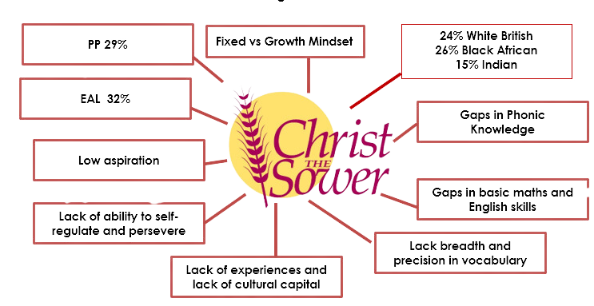
The Big Picture

Slide 6
The Big Picture
So how do we live out our vision for the children?

Slide 7


The Big Picture
RE Curriculum
Collective Worship
A WHOLE SCHOOL APPROACH
Our Vision
Enrichment
Wider Curriculum
Spirituality
Enabling our children to become successful, well rounded, responsible and caring young people.

Slide 8



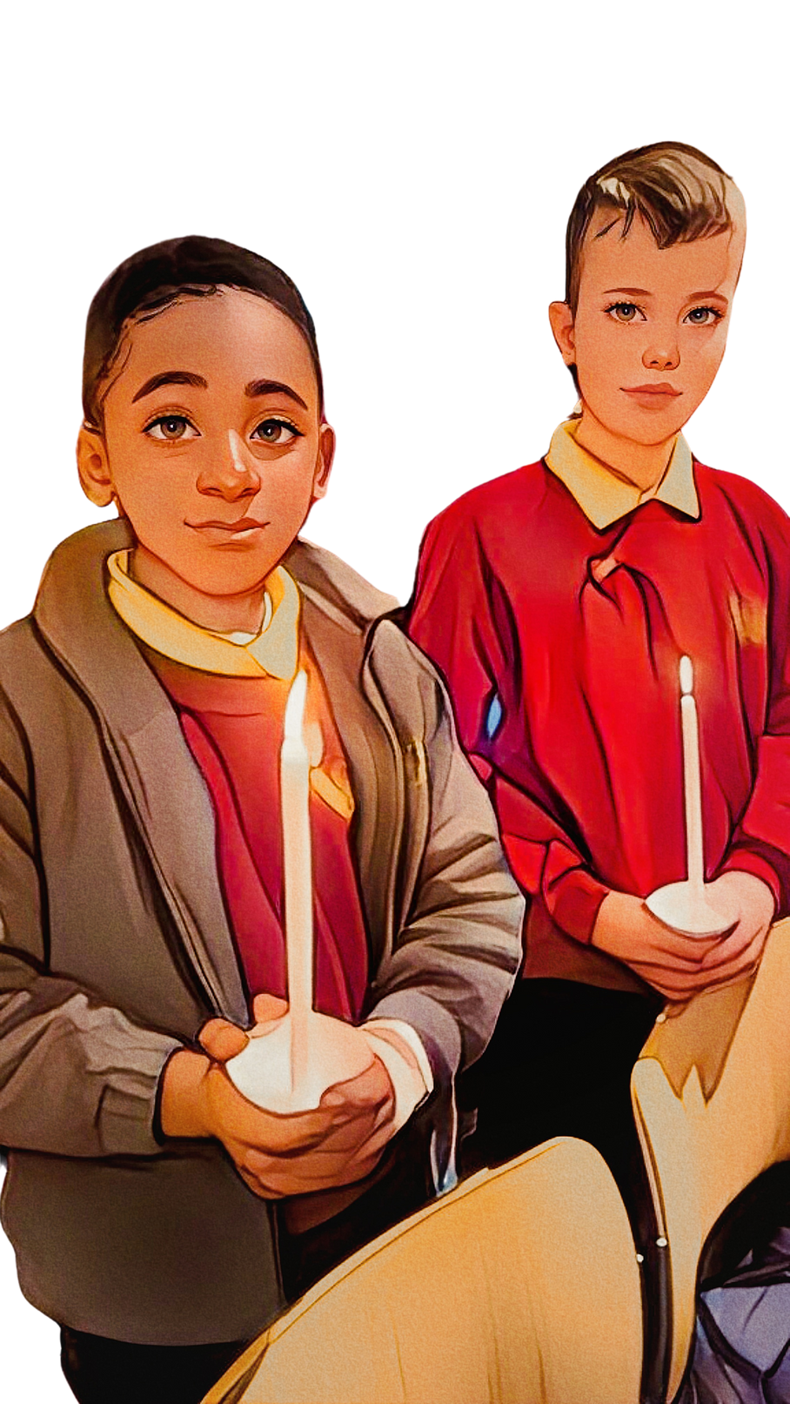


RE
is a Core Subject - why?

Slide 9


RE and Worldviews
  RE has changed
  RE is about more than just faith.

Slide 10



Christ Disciplines of RE
HUMAN/SOCIAL
SCIENCES
PHILOSOPHY
THEOLOGY
This is about
thinking.
This is about
believing.
This is about
living
Philosophy is about finding out how and whether things
make sense.
It deals with questions of
morality and ethics. It takes
seriously questions about
reality, knowledge and
existence.
This explores the diverse
ways in which people
practise their beliefs. They engage with the impact of
beliefs on individuals,
communities and societies.
Theology looks at
where beliefs come from,
how they have changed over
time, how they are applied
differently in different
contexts and how they relate
to each other

Slide 11

‘Our curriculum should whisper to our children “you belong. You did not come from nowhere. You are one of us. All this came before you, and one day you too might add to it.’
Ben Newmark
Worldviews- why the name change?
‘Worldview’ describes the way in which a
person encounters, interprets, understands and
engages with the world.

Slide 12
We now teach that everyone has a different Worldview - even if they practice the same religion as you, they will not see the world, or believe in or practice their faith in the same way as you.
And that is okay!
How does this impact what we teach?
EG: looking at a mosque – labelling a mosque says that all mosques are the same. We need to say where the mosque is and which type of Muslims worship there. It would be like putting a picture of CTS up and saying that all schools look like this.

Slide 13
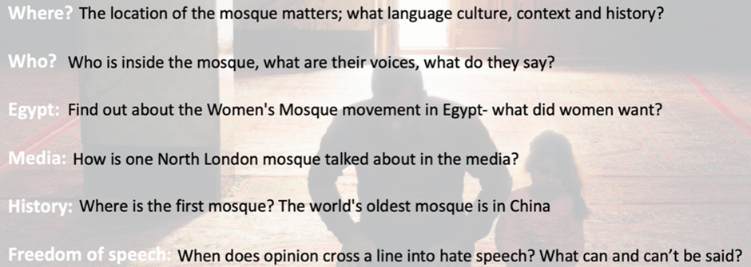
So, instead of labelling a mosque we might...

Slide 14
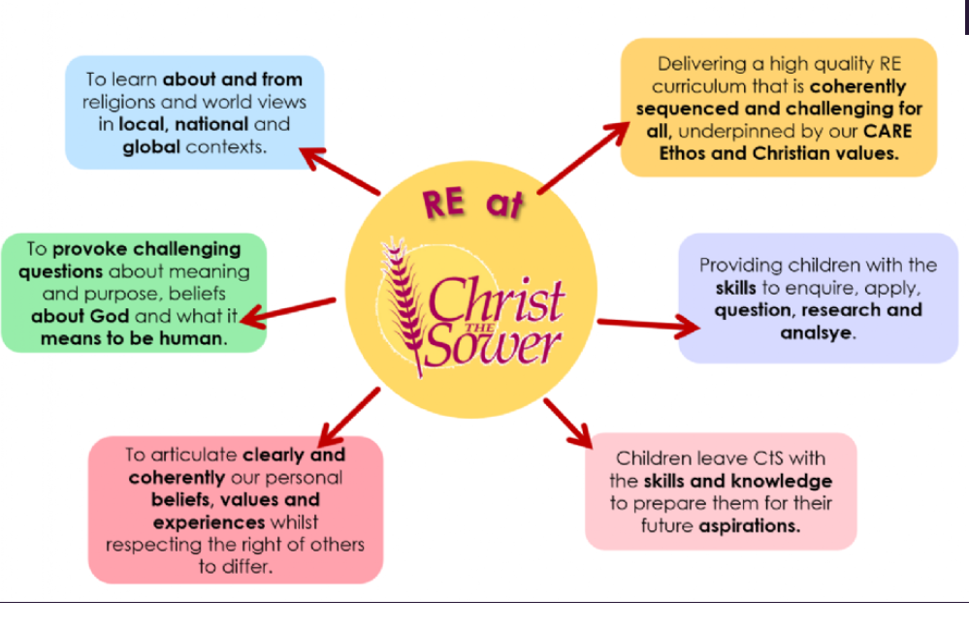

Slide 15








Intent
Connections between faiths and worldviews
Religious Literacy
Challenge
Curiosity
Big Questions
Articulation
Reflection

Slide 16
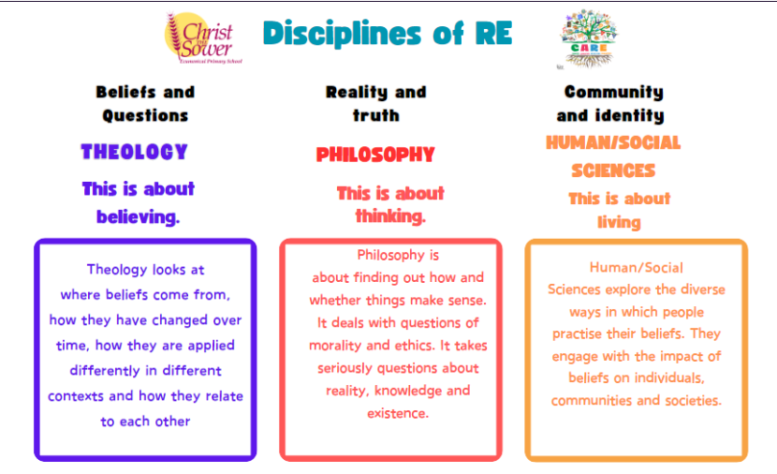

Slide 17

Our Local Church Community
Our Ecumenical Partnership involves the Baptist Union, Church of England, Methodist Church, the United Reformed Church, and this is reflected in the many different styles of worship. We have five church buildings and a church school, ranging in age from the 12th Century to modern day, and some of these also serve as community centres during the week.
Can you guess the name of the school?
Can you name any of the churches?

Slide 18

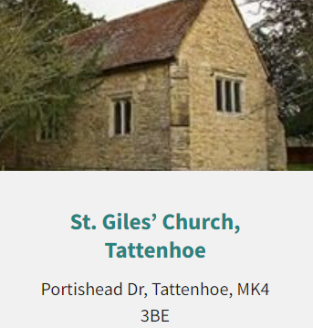
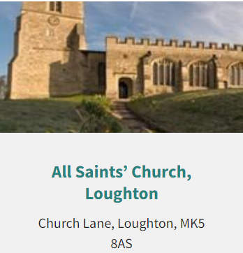
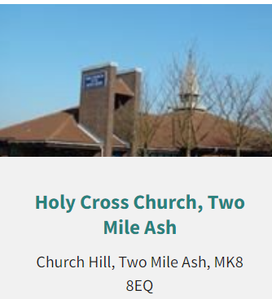
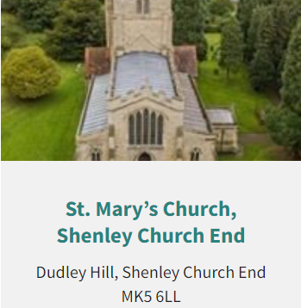
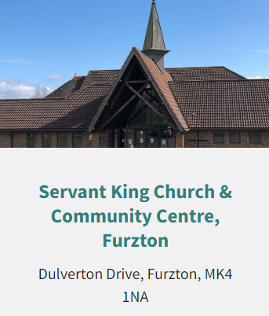
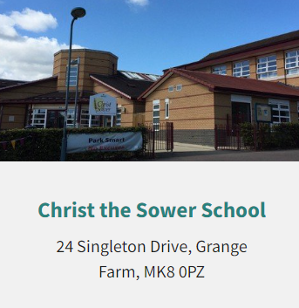


Slide 19

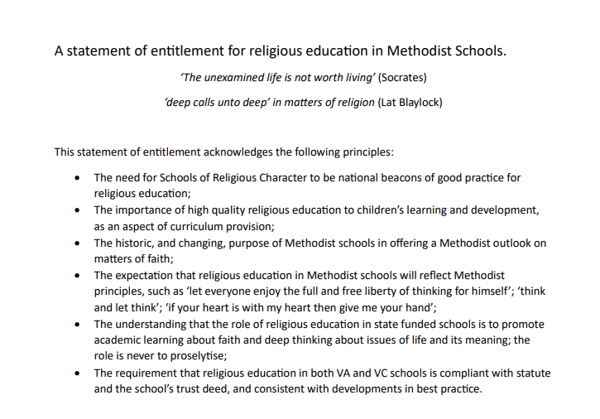



Slide 20
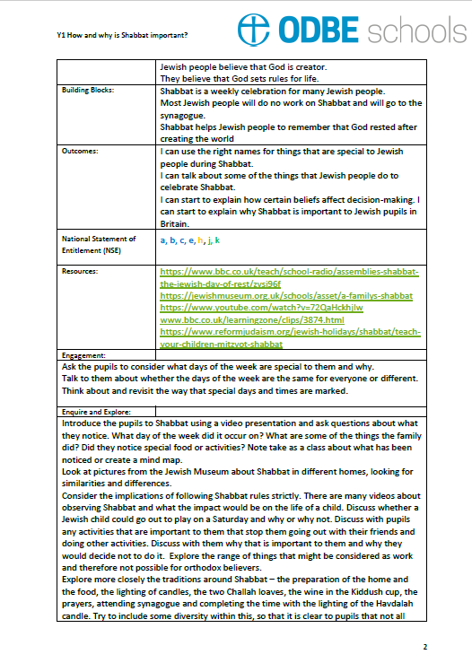
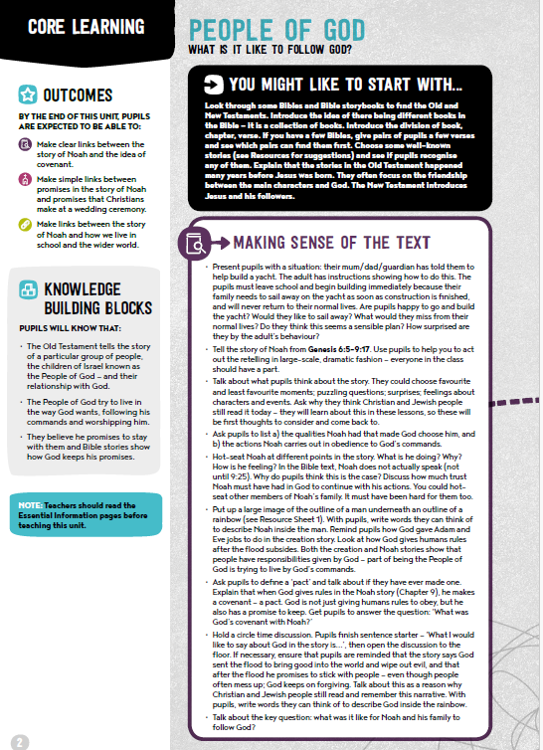
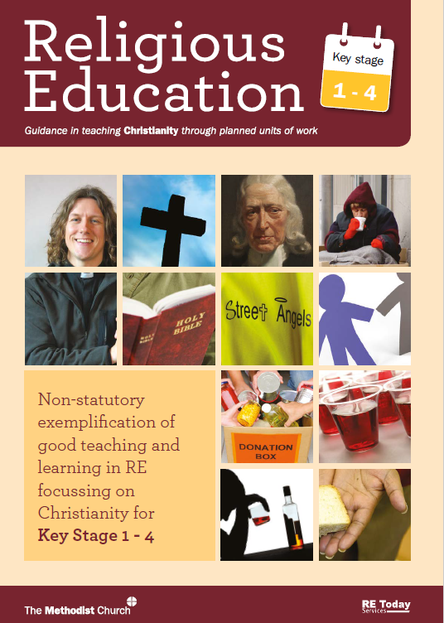

Slide 21
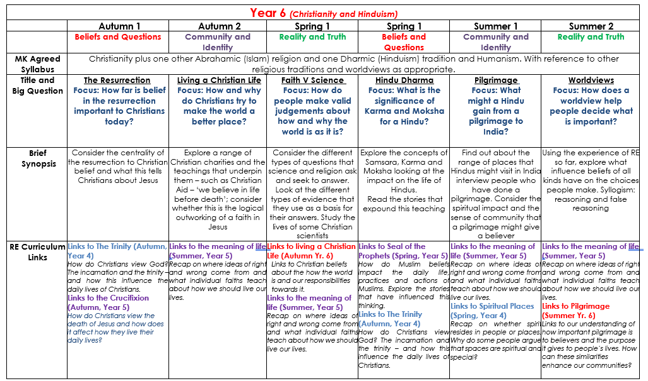

Slide 22
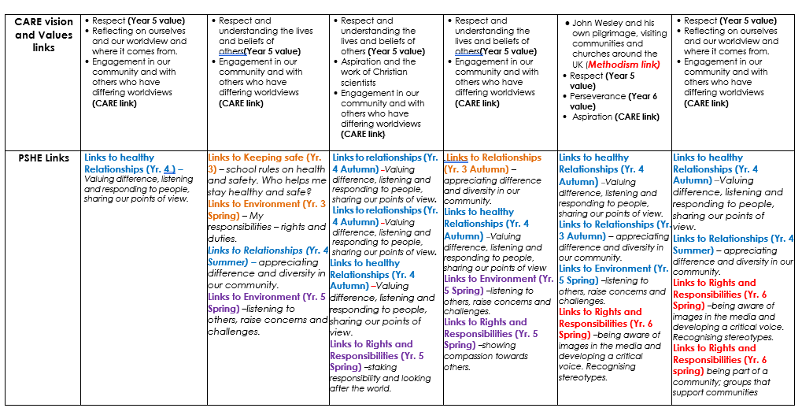

Slide 23
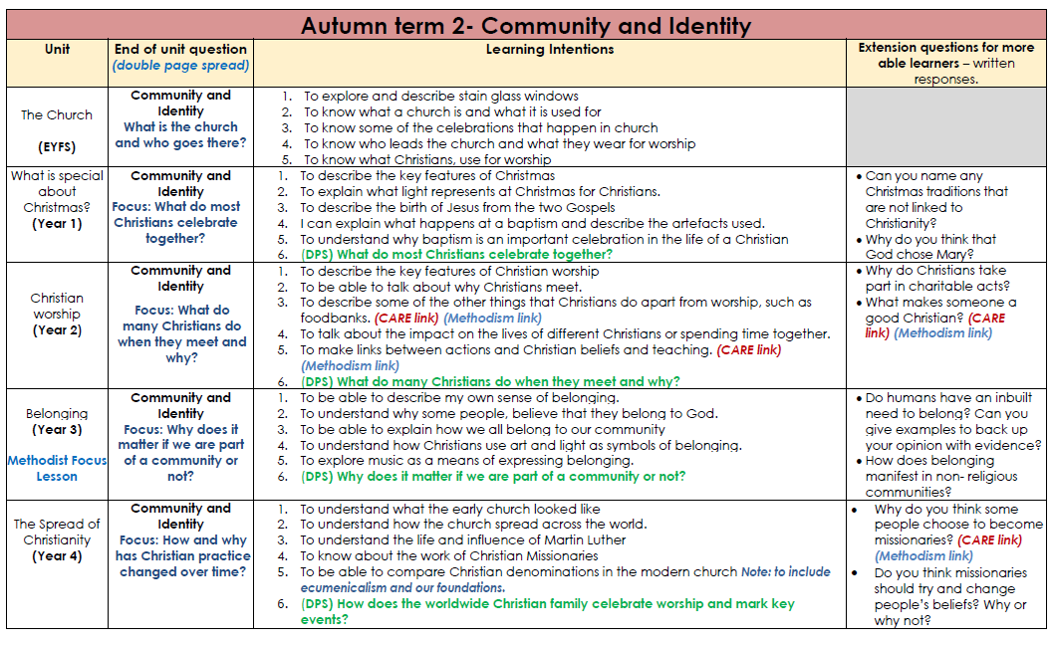

Slide 24
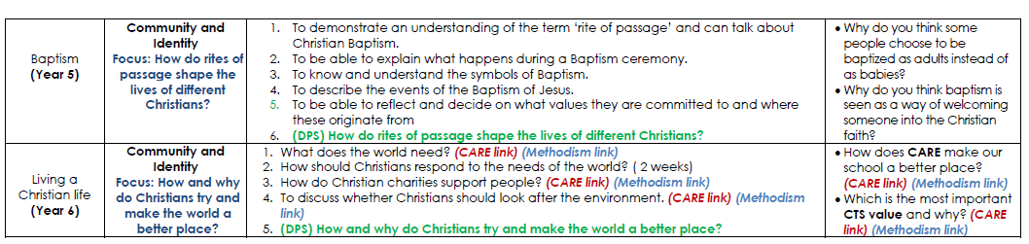

Slide 25
Ows, Wows and Nows
The Wows
These are the awe and wonder moments. The times when you want to breathe in and capture the feeling, holding onto it as long as you can.
The Nows
These are the every day ordinary times:
being able to be present in the moment,
thinking of what we have now and how lucky we are to be here, now
(Being thankful - God is not just for emergencies)

Slide 26
Ows, Wows and Nows
The Nows
These are the every day ordinary times:
being able to be present in the moment,
thinking of what we have now and how lucky we are to be here, now (Being thankful - God is not just for emergencies)

Slide 27
Ows, Wows and Nows
The Ows
These are the things that can go wrong. They can knock the breath out of you.

Slide 28
Spirituality Day 21st November
Phonics KS1 Reading (poetry) KS2
940 am - Collective Worship.
session 1 – NOW – mirror moments – how much time do we spend thinking about how special we are?
session 2 – Prayer Space session (based around the environment and climate change - A combined NOW, WOW and OW moment)
session 3 – OW – how does it feel when something breaks? Are we taking good care of God’s world? How can we fix it?
session 4 – WOW – marvelling in nature
art and music used to help us live in the present moment.

Slide 29
  CARE crew
  Soul Space
  Prayer Spaces in classrooms.
  SIAMS reminders

