Slide 1


World Environment
Day

Slide 2
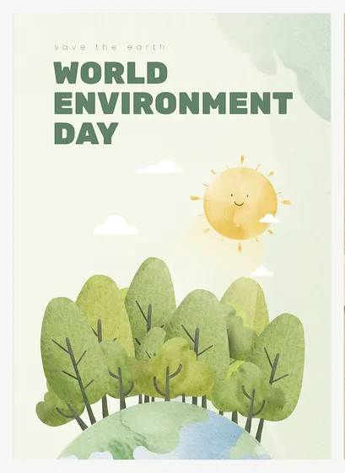
WORLD ENVIRONMENT DAY
World Environment Day takes place every year on the 5th June.
It was set up in 1973 by the United Nations.
That means this year is the 50th anniversary.
Notes:
World Environment Day takes place every year on the 5th June.
It was set up in 1973 by the United Nations.
That means this year is the 50th anniversary.

Slide 3

WORLD ENVIRONMENT DAY
It is now celebrated in over 143 countries around the world.
Notes:
It is now celebrated in over 143 countries all around the world.

Slide 4
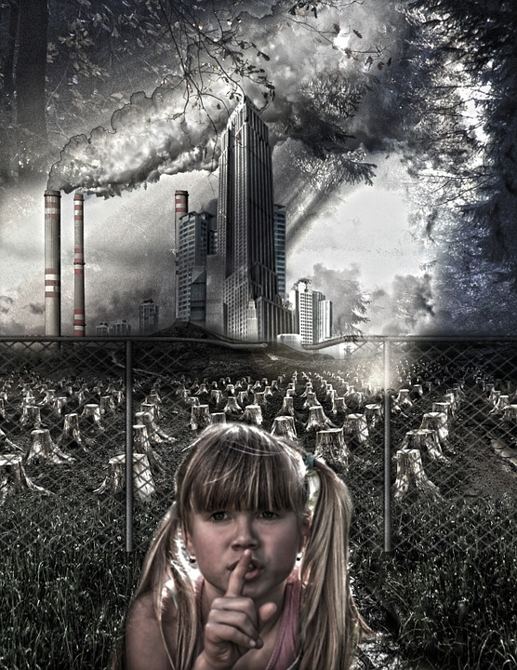
WORLD ENVIRONMENT DAY
World Environment Day was set up to raise awareness of our planet Earth and the issues around it’s wellbeing.
It raises awareness to encourage worldwide action to protect the environment.
Notes:
World Environment Day was set up to raise awareness of our planet Earth and the issues around it’s wellbeing.
It raises awareness to encourage worldwide action to protect the environment.

Slide 5
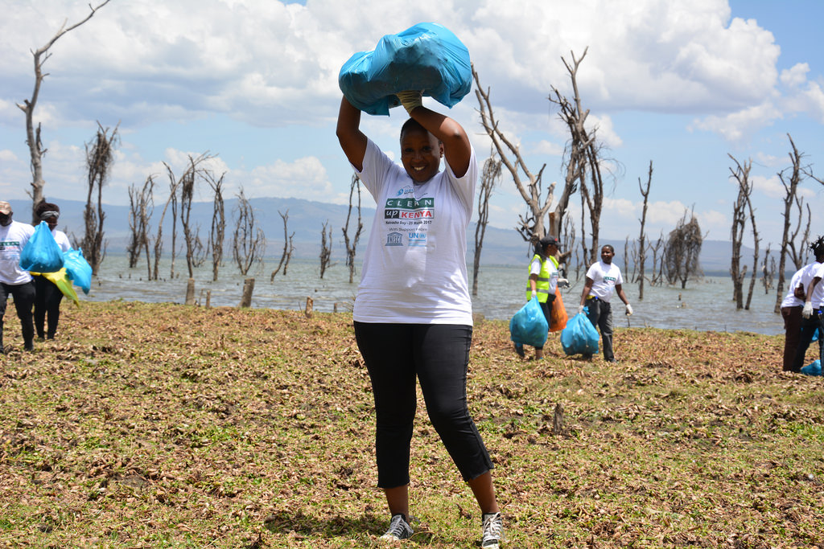
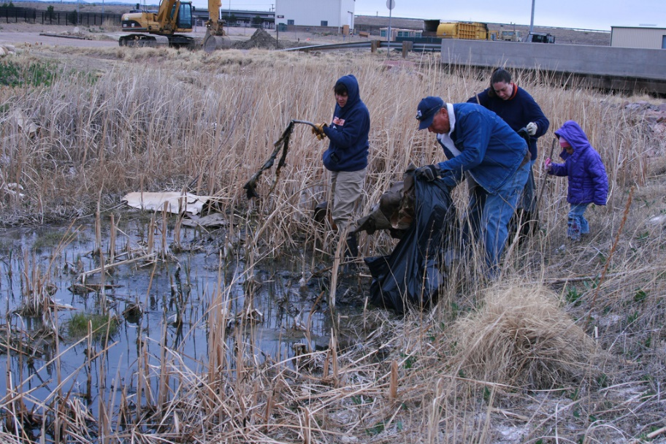
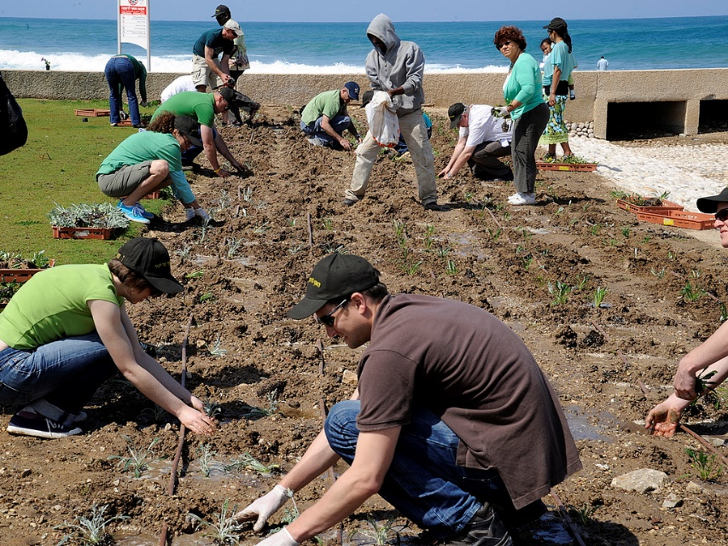
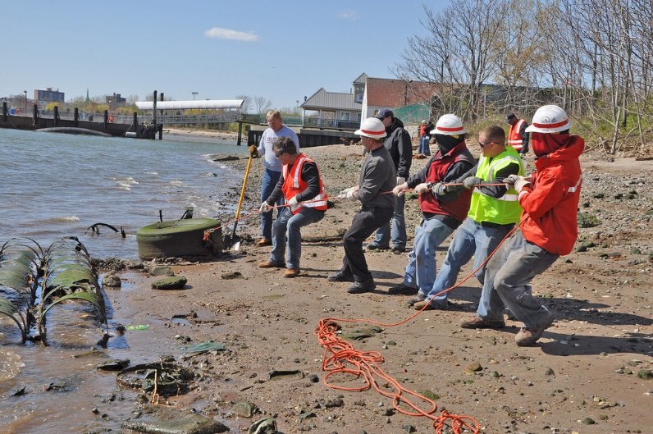
WORLD ENVIRONMENT DAY
Since World Environment Day began in 1973, hundreds of thousands of events have been organised around the world to improve the environment.
Notes:
Since World Environment Day began in 1973, hundreds of thousands of events have been organised around the world to improve the environment.

Slide 6
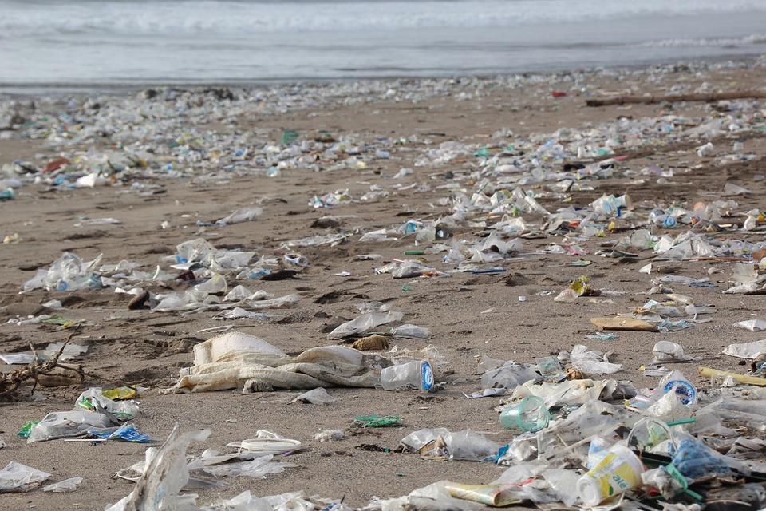
WORLD ENVIRONMENT DAY
Projects have included community clean-ups, action against illegal trade in wildlife, replanting forests and reducing plastic pollution.
Notes:
Projects have included community clean-ups, action against illegal trade in wildlife, replanting forests and reducing plastic pollution.

Slide 7
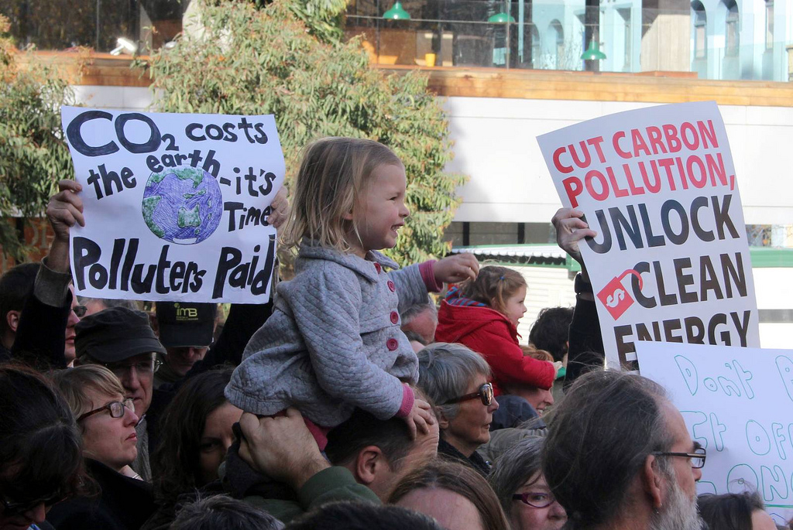
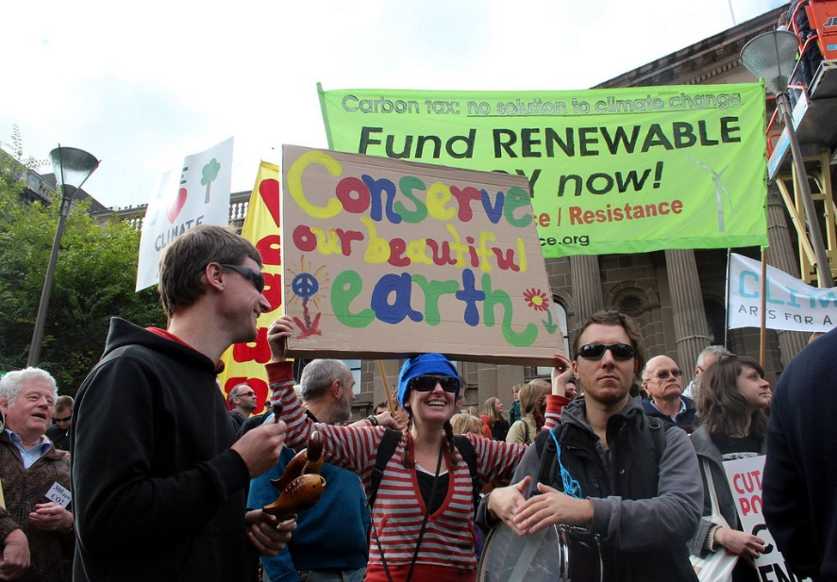
WORLD ENVIRONMENT DAY
In many countries, World Environment Day is used to draw political attention and action to improving the environment.
Many campaigns and rallies take place highlighting the environmental issues that require government intervention and action.
Notes:
In many countries, World Environment Day is used to draw political attention and action to improving the environment.
Many campaigns and rallies take place highlighting the environmental issues that require government intervention and action.

Slide 8

WORLD ENVIRONMENT DAY
In 2021, the UN launched the ‘United Nations Decade on Ecosystem Restoration’.
Notes:
In 2021, the UN launched the ‘United Nations Decade on Ecosystem Restoration’.
Does anyone know what an Ecosystem is?

Slide 9
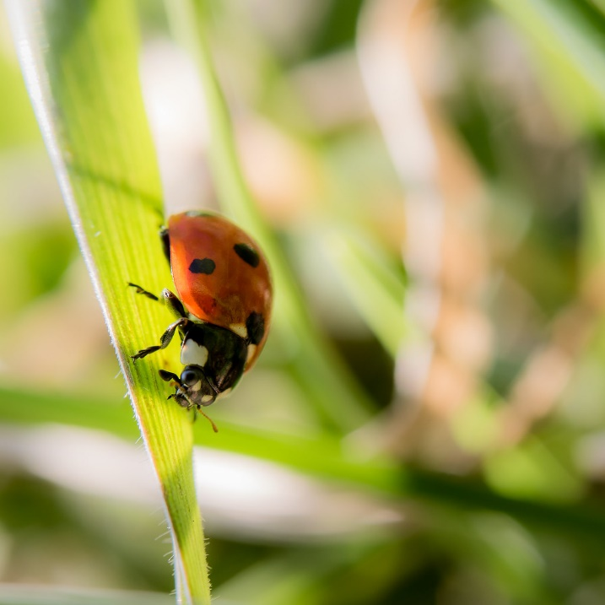
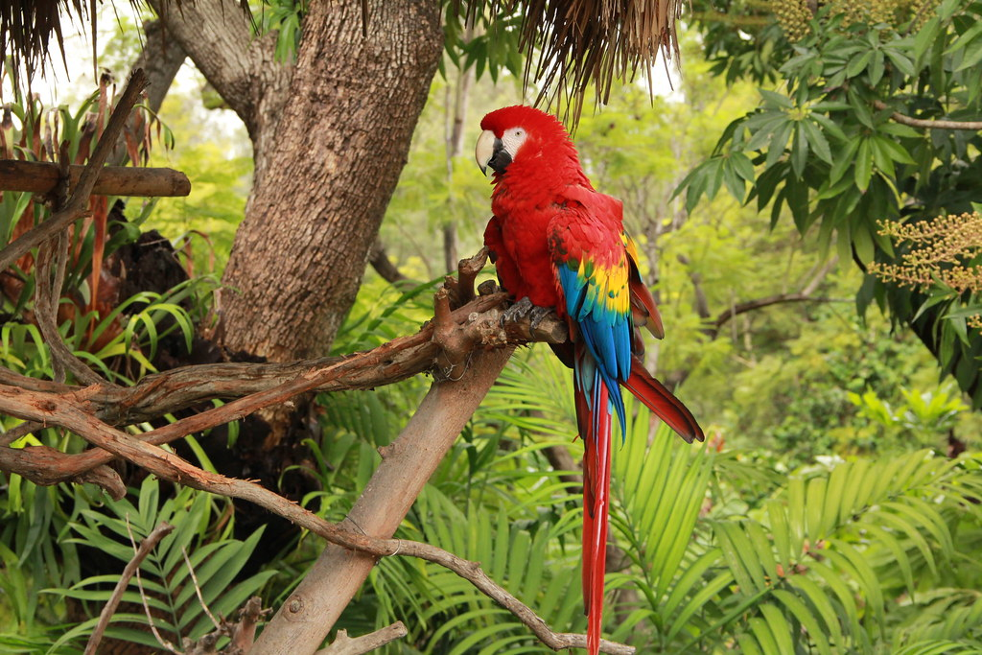
WORLD ENVIRONMENT DAY
An ecosystem is a community of interacting organisms and their environment.
Living things interact with each other and also with non-living things like soil, water and air.
Ecosystems support all life on Earth; the healthier our ecosystems, the healthier the planet - and its people.
Notes:
An ecosystem is a community of interacting organisms and their environment.
Living things interact with each other and also with non-living things like soil, water and air.
Ecosystems support all life on Earth; the healthier our ecosystems, the healthier the planet - and its people.

Slide 10
WORLD ENVIRONMENT DAY
The UN Decade on Ecosystem Restoration will run until 2030.
This is the timeline that scientists have identified as the last chance to make an important change to climate change.
Notes:
The UN Decade on Ecosystem Restoration will run until 2030.
This is the timeline that scientists have identified as the last chance to make an important change to climate change.

Slide 11
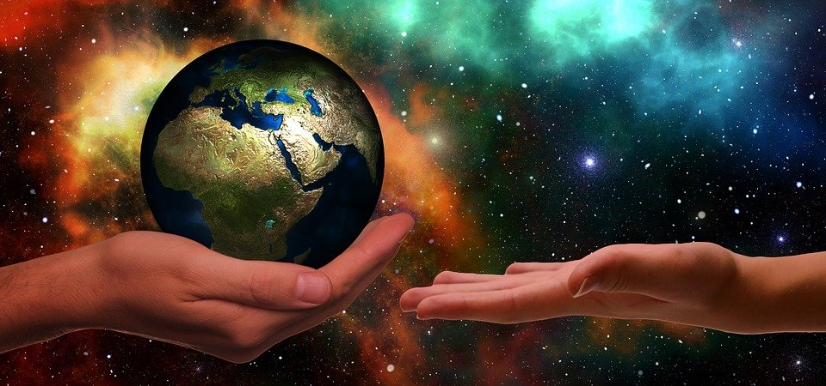
WORLD ENVIRONMENT DAY
The United Nations Decade on Ecosystem Restoration aims to prevent, stop and reverse the destruction of ecosystems on every continent and in every ocean.
Notes:
The United Nations Decade on Ecosystem Restoration aims to prevent, stop and reverse the destruction of ecosystems on every continent and in every ocean.

Slide 12

WORLD ENVIRONMENT DAY
Protecting ecosystems is very important as one million plant and animal species are facing extinction.
We need healthy ecosystems!
Biodiversity is very important.
Each species, no matter how small, has an important role to play in the ecosystem.
Notes:
Protecting ecosystems is very important as one million plant and animal species are facing extinction (which means there will be none left!).
We need healthy ecosystem!
Biodiversity is very important. It means there is a variety of living things and each species, no matter how small, has an important role to play in the ecosystem.

Slide 13

WORLD ENVIRONMENT DAY
The aim of World Environment Day is to encourage people to do something to take care of the environment and become an Eco-Warrior.
Notes:
The aim of World Environment Day is to encourage people to do something to take care of the environment and become an Eco-Warrior.

Slide 14










WORLD ENVIRONMENT DAY
Biodiversity
Energy
Global Citizenship
Transport
Water
School Grounds
Waste
Litter
Marine
Healthy Living
Notes:
Recently, as Eco-Warriors, we carried out an environmental review looking at these 10 areas:
Biodiversity – having lots of plants and wildlife
Water – valuing and preserving this important resource
Energy – Reducing energy use where possible and investigating greener energy sources.
Global Citizenship – Taking an active role in the community to make our planet more peaceful and sustainable
Transport – Promoting and encouraging sustainable transport – like walking or cycling where we can.
School Grounds – Improving school grounds for students, staff, insects and animals.
Healthy Living – Addressing our own health and how that can link to the environment.
Litter – Reducing litter that harms wildlife when not put in the bin.
Marine – Protecting water-based ecosystems like the pond.
Waste – Reducing, reusing, repairing and recycling what we can.
This gave us an idea of what we are doing well at as a school and which areas we can focus on improving.

Slide 15
WORLD ENVIRONMENT DAY
So what can we do?
Biodiversity
Energy
Global Citizenship
Transport
Water
School Grounds
Waste
Litter
Marine
Healthy Living
Notes:
So what can we do now?

Slide 16
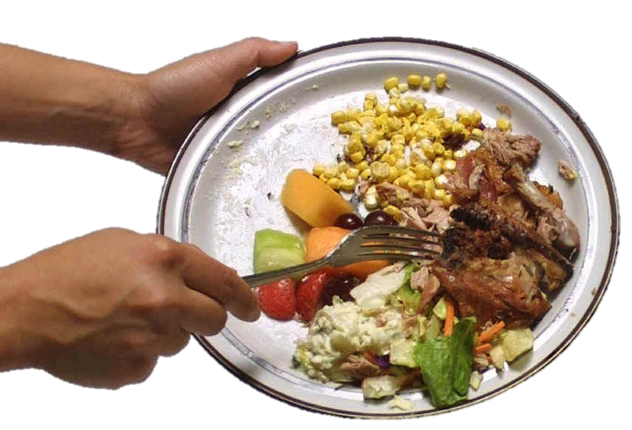
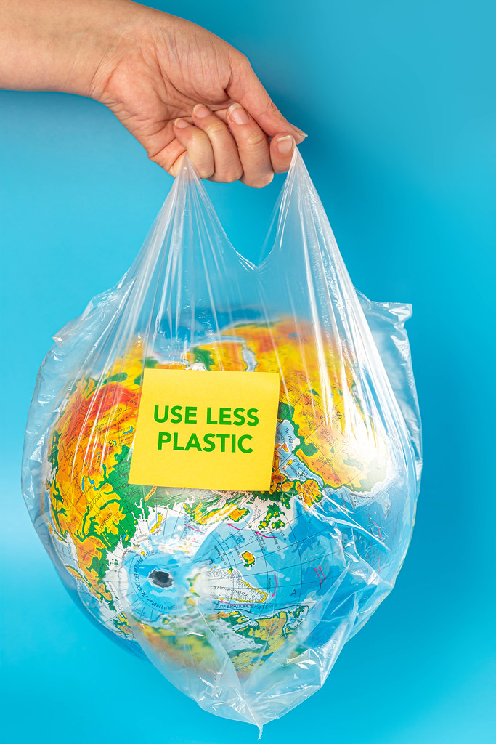
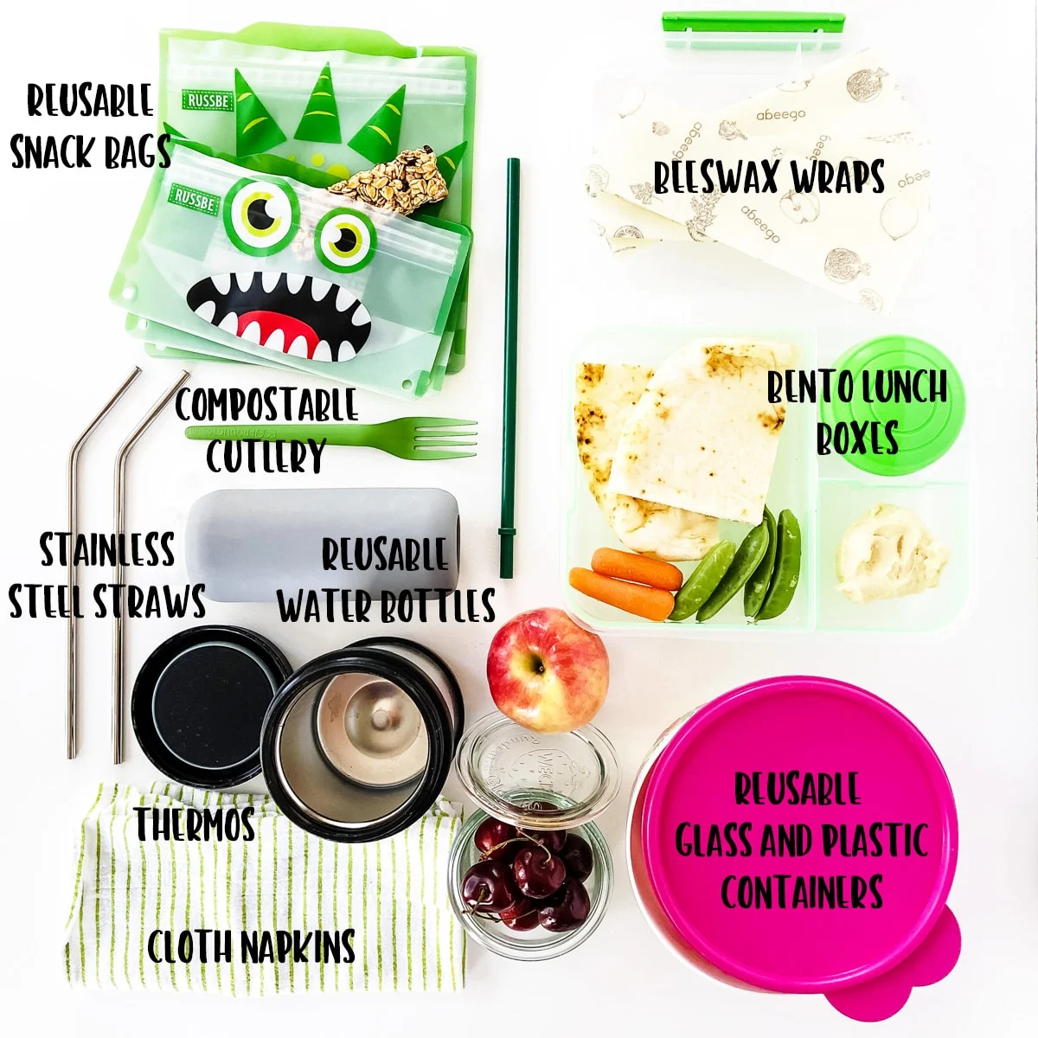


WORLD ENVIRONMENT DAY
Notes:
Be aware of how much plastic we are using as this can’t be recycled and can end up harming animals on land and in the sea.
Make sure we recycle when possible. All classrooms have the recycling boxes so please make sure the right rubbish is going in these. As your eco-warrior if you are not sure!
Reducing our food waste at lunch time.
Turning off the lights when we leave a room to save on energy.
Using reusable pots and bags in our packed lunch boxes so that there is less that needs to be thrown away.

Slide 17
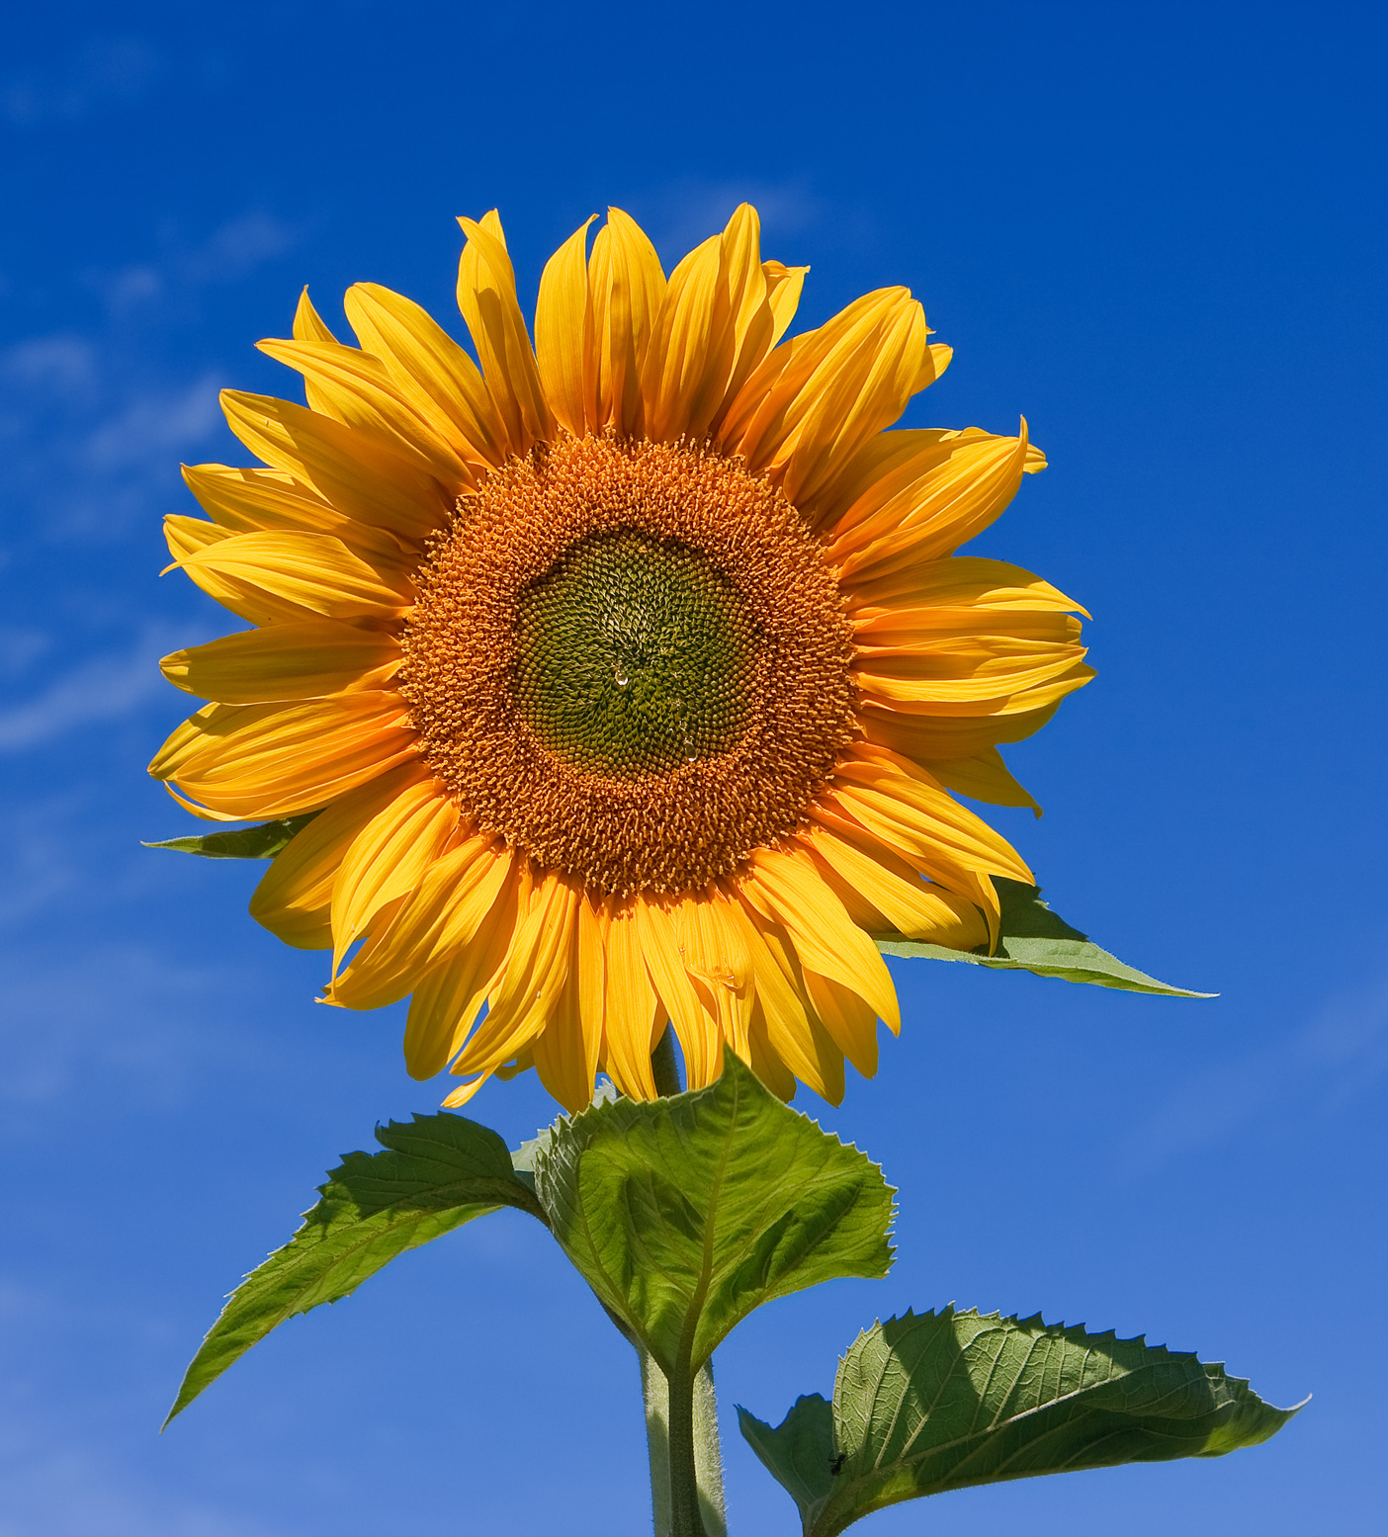
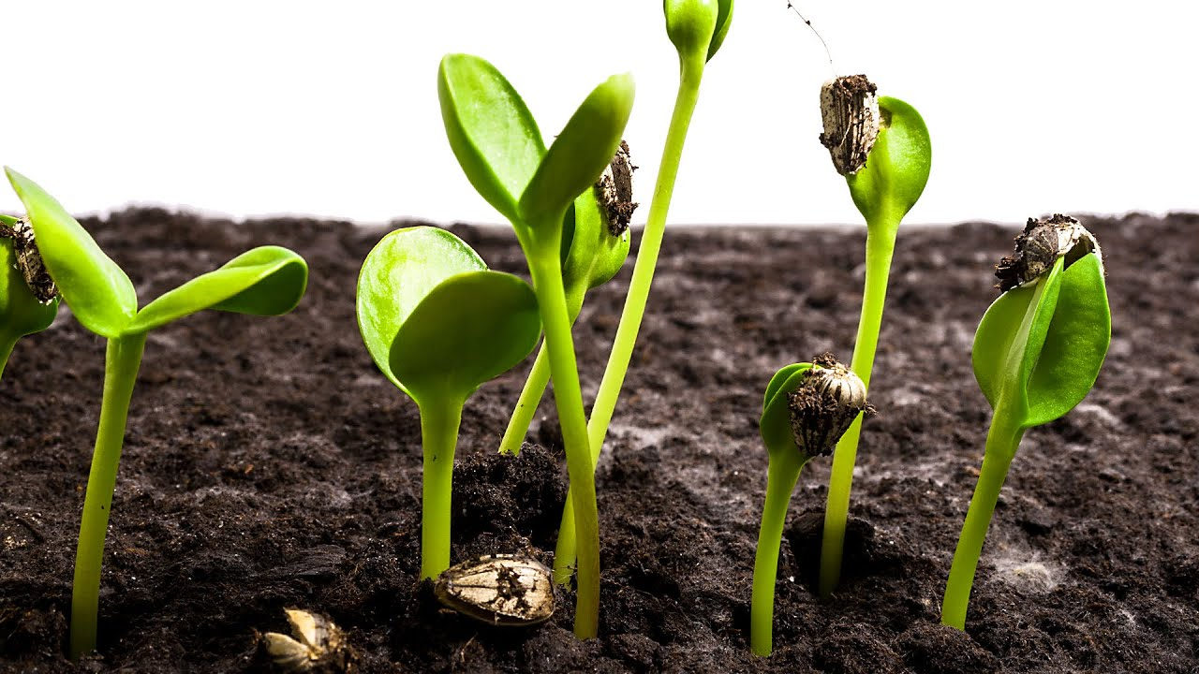
WORLD ENVIRONMENT DAY
1
Biodiversity
Notes:
We have decided to start by focusing on biodiversity as we start this summer half term.
We are all going to take part in a sunflower challenge to get us excited about growing our own plants!
Each class will have a sunflower seed and they will be responsible for nurturing it and giving it everything it needs to grow.
By the summer holidays we will see which class has grown the tallest!
Next year, following on from this we hope to start up the gardening club again so that we can continue growing our own plants and maybe even some of our own vegetables!

Slide 18
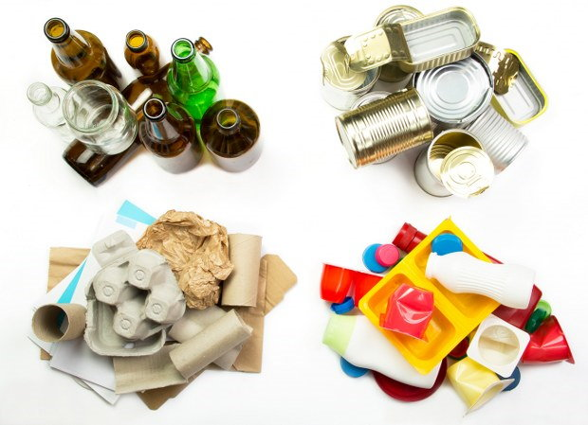
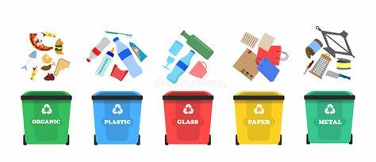
Reducing Food Waste
2
Litter

Slide 19

WORLD ENVIRONMENT DAY
3
Waste

Slide 20

WORLD ENVIRONMENT DAY
This is our starting point for change.
Watch this space for more plans of action, to make every day an Environment Day!
Notes:
This is our starting point for change.
Watch this space for more plans of action, to make every day an Environment Day!

Slide 21
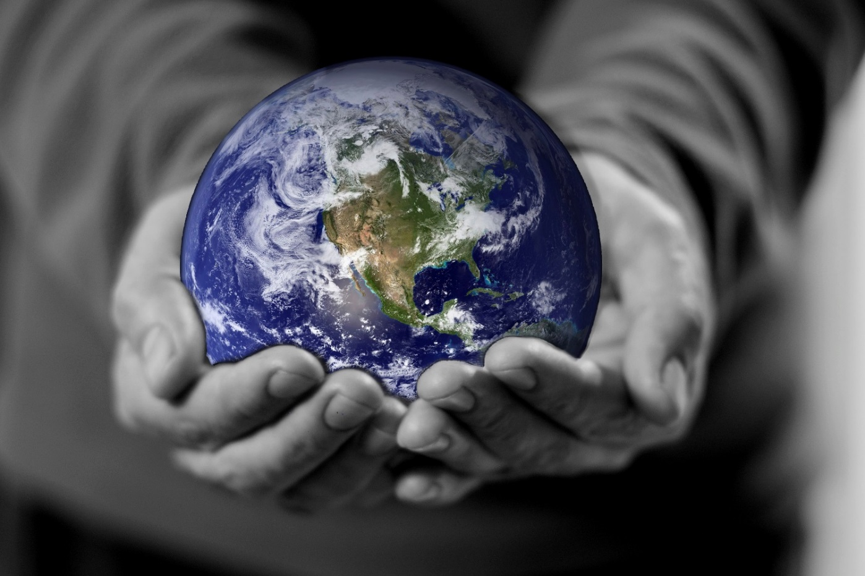
WORLD ENVIRONMENT DAY
Thank you for listening!
https://www.youtube.com/watch?v=OyeXIO8s1UU
Notes:
Thank you for listening!

