Slide 1










Slide 2

EARTH
Day 2024
Planet Vs Plastics

Slide 3



What is Earth Day?

Slide 4
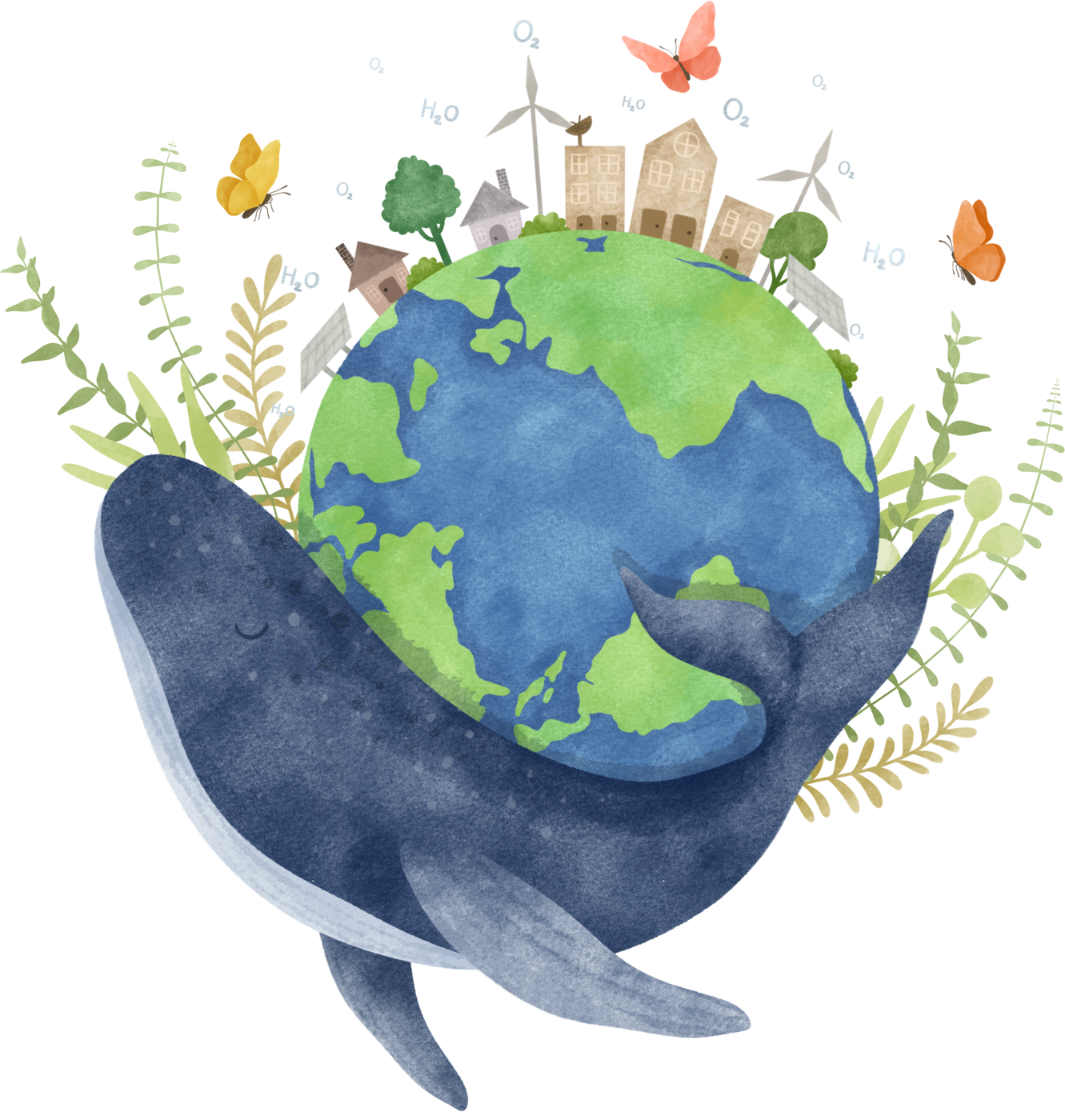
Earth Day is a worldwide event celebrated on April 22nd each year. It is a day dedicated to raising awareness about environmental issues and promoting actions to protect our planet.
People around the globe come together to participate in various activities such as tree planting, beach clean-ups, recycling drives, and educational events.
Earth Day serves as a reminder that we all have a responsibility to take care of the Earth and make sustainable choices in our daily lives. It is a time to reflect on the beauty of our planet and the importance of preserving it for future generations.

Slide 5








This year’s theme is
PLANET VS PLASTICS
Why is this an important issue?
What does this mean?

Slide 6










Why?
The Problem with Plastic...
  Plastic pollution is one of the most biggest challenges facing the world today, it has a profound and far-reaching impact on ecosystems, wildlife, and human health.
  The widespread use of plastic has led to its presence in the environment, from oceans to remote wilderness areas.
  Plastic poses significant threats to marine life, with millions of animals entangled or ingesting plastic.
  The breakdown of plastics into microplastics has led to contamination of water sources and the food chain, which is bad for human health.
More than 500 billion plastic bags were produced last year. They have a working life of minutes and then often spend centuries in landfills.

Slide 7








THE LIFE CYCLE OF PLASTIC
Plastic Bag
Coffee Cup
Plastic Straw
20 years
30 years
200 years
Plastic Bottle
Plastic Toothbrush
450 years
500 years

Slide 8
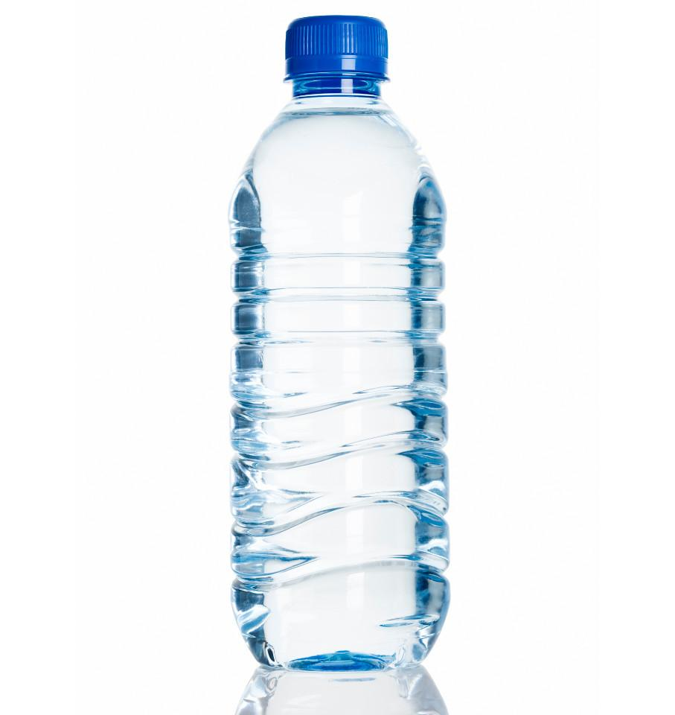
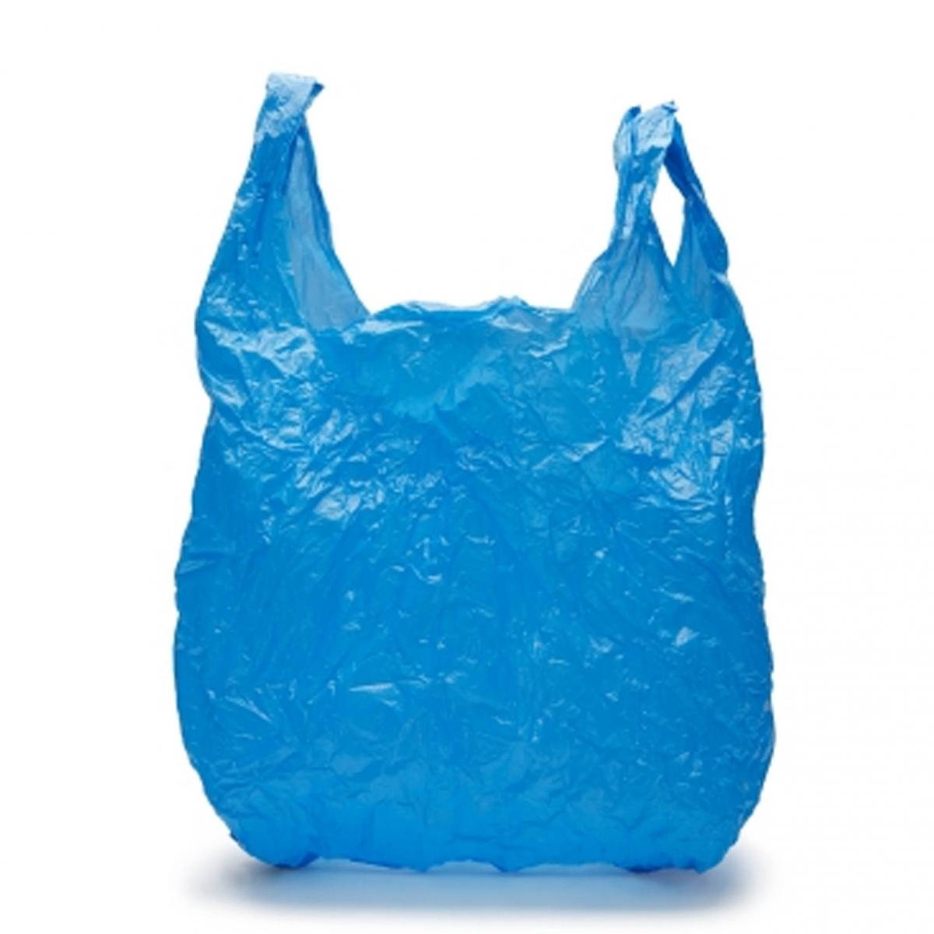
What is it?
Amongst the items harming our oceans are:
Single use plastics such as:
Straws.
Plastic carrier bags.
Plastic water bottles.
Plastic micro-beads found in some toothpastes, facial wash and other toiletries.
Plastic can binders/holders.

Slide 9
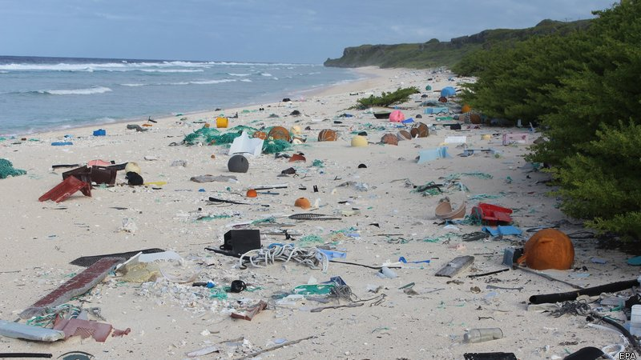
Where does this come from?
Plastic pollution comes from:
Our litter, such as overflowing bins near beaches.
Poorly managed waste, and litter blown by the wind.
Sewage systems that feed into the sea.
Packaging and lost crates from cargo ships.
All of this plastic causes harmful pollution and it is directly caused by us.

Slide 10
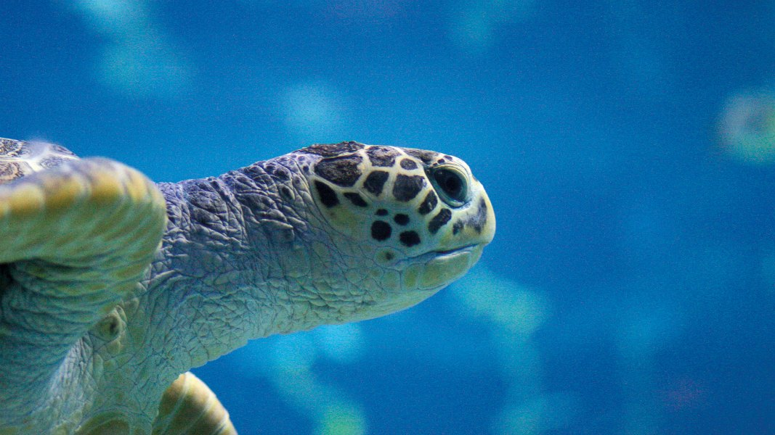
Sea life
Plastics injure and kill fish, sea birds and marine mammals.
693 species of marine life have been affected including all seven species of sea turtle, nearly half of marine mammals, 20% of all seabird species.
Every year over 100,000 marine mammals and 1 million seabirds are killed by marine debris.
A lot of sea life are eating plastic, getting trapped and caught up in plastic or getting plastic stuck to or inside them.

Slide 11
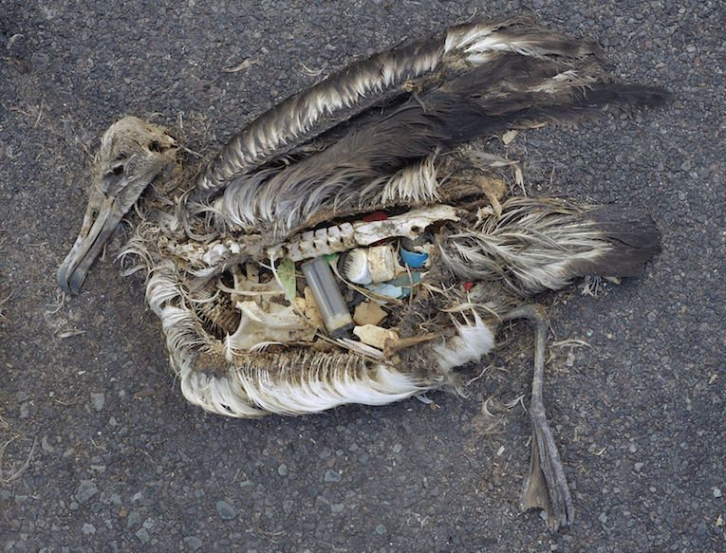
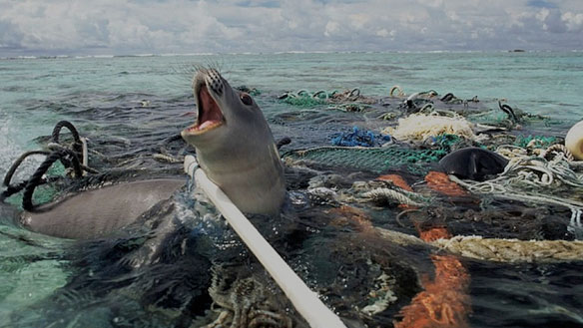
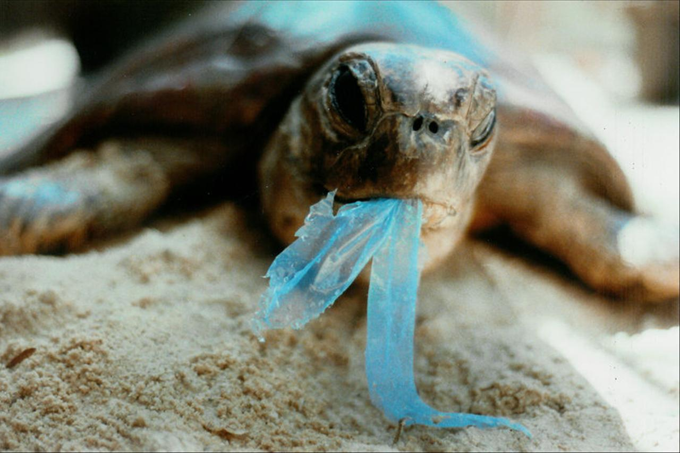
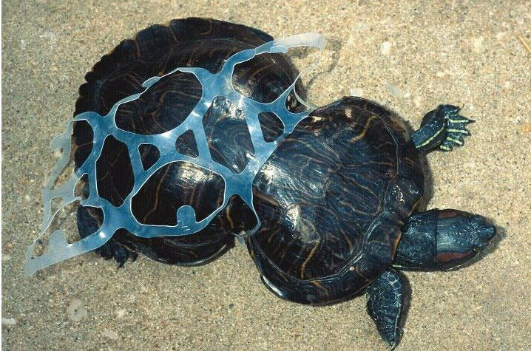
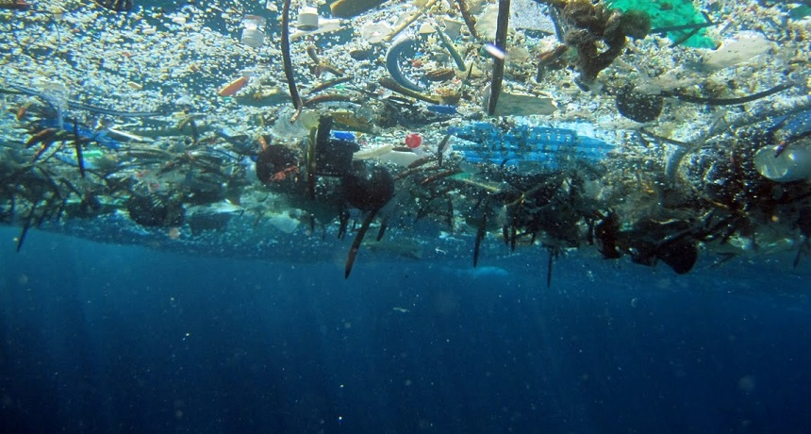
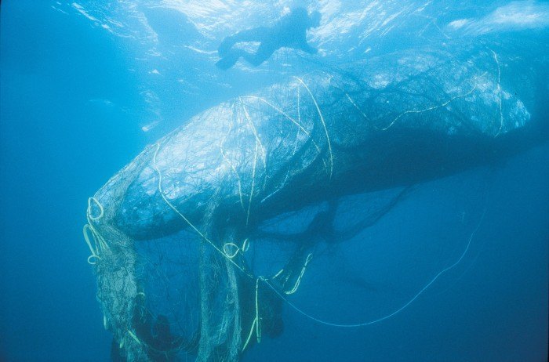
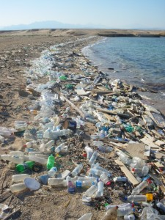
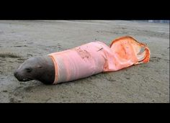
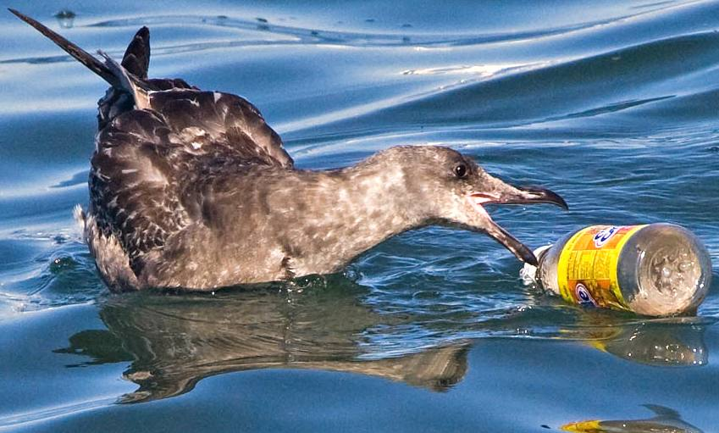
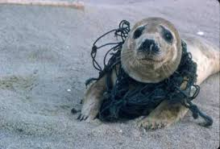
This is what rubbish is doing to sea life

Slide 12



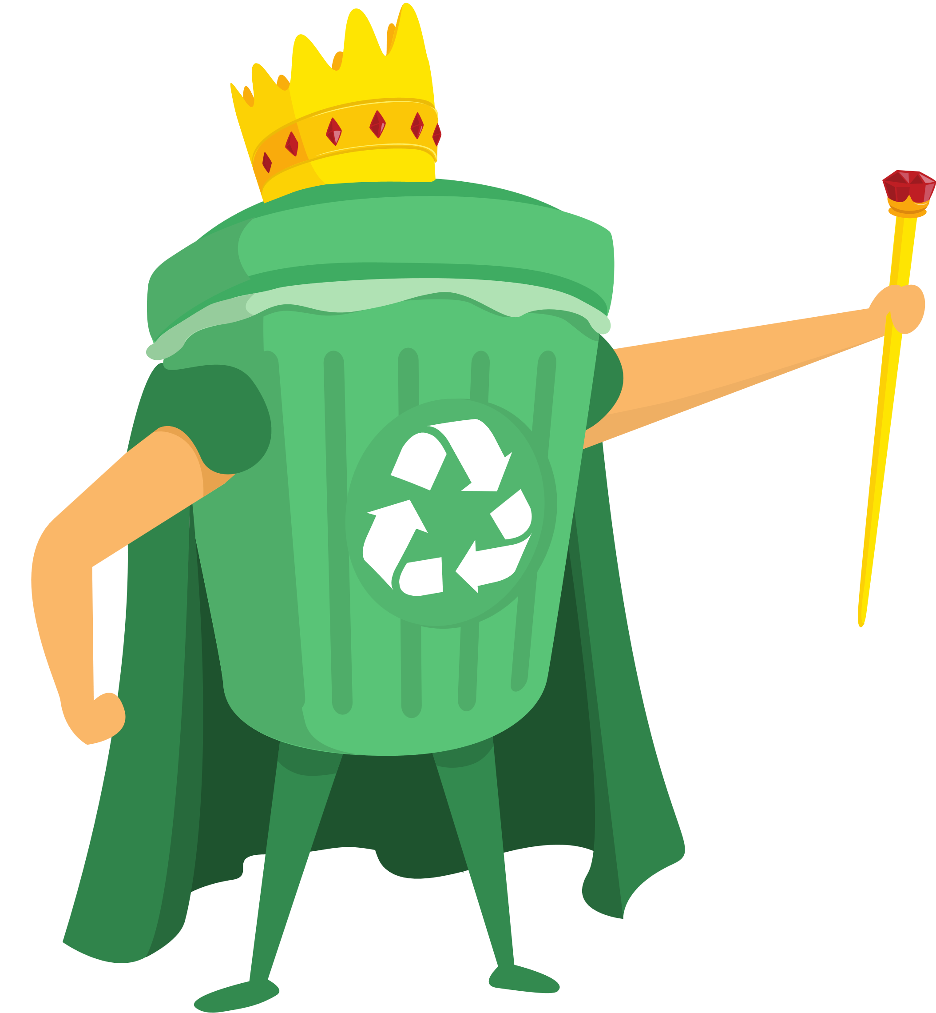


What can we do about it?

Slide 13
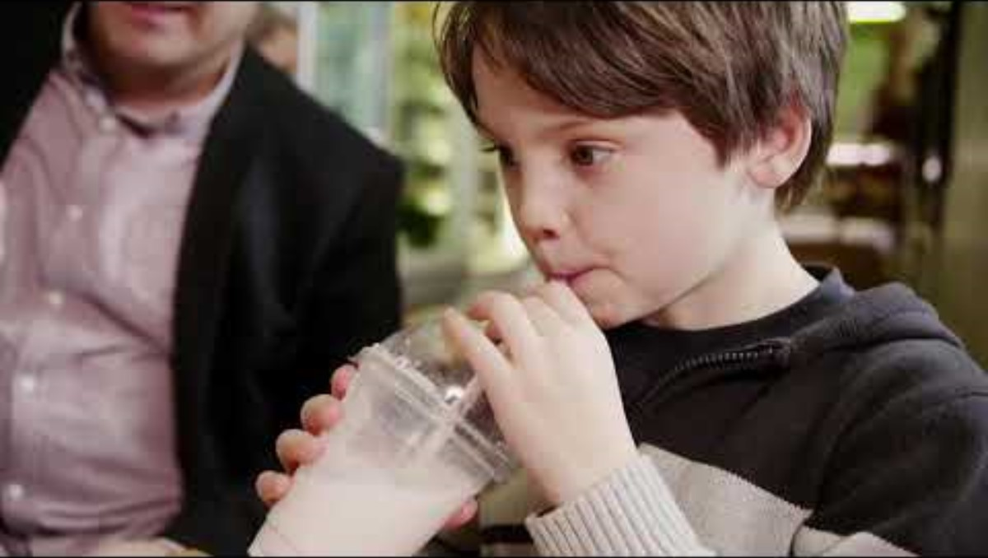
Why is plastic pollution so bad?
What can we do about it?

Slide 14
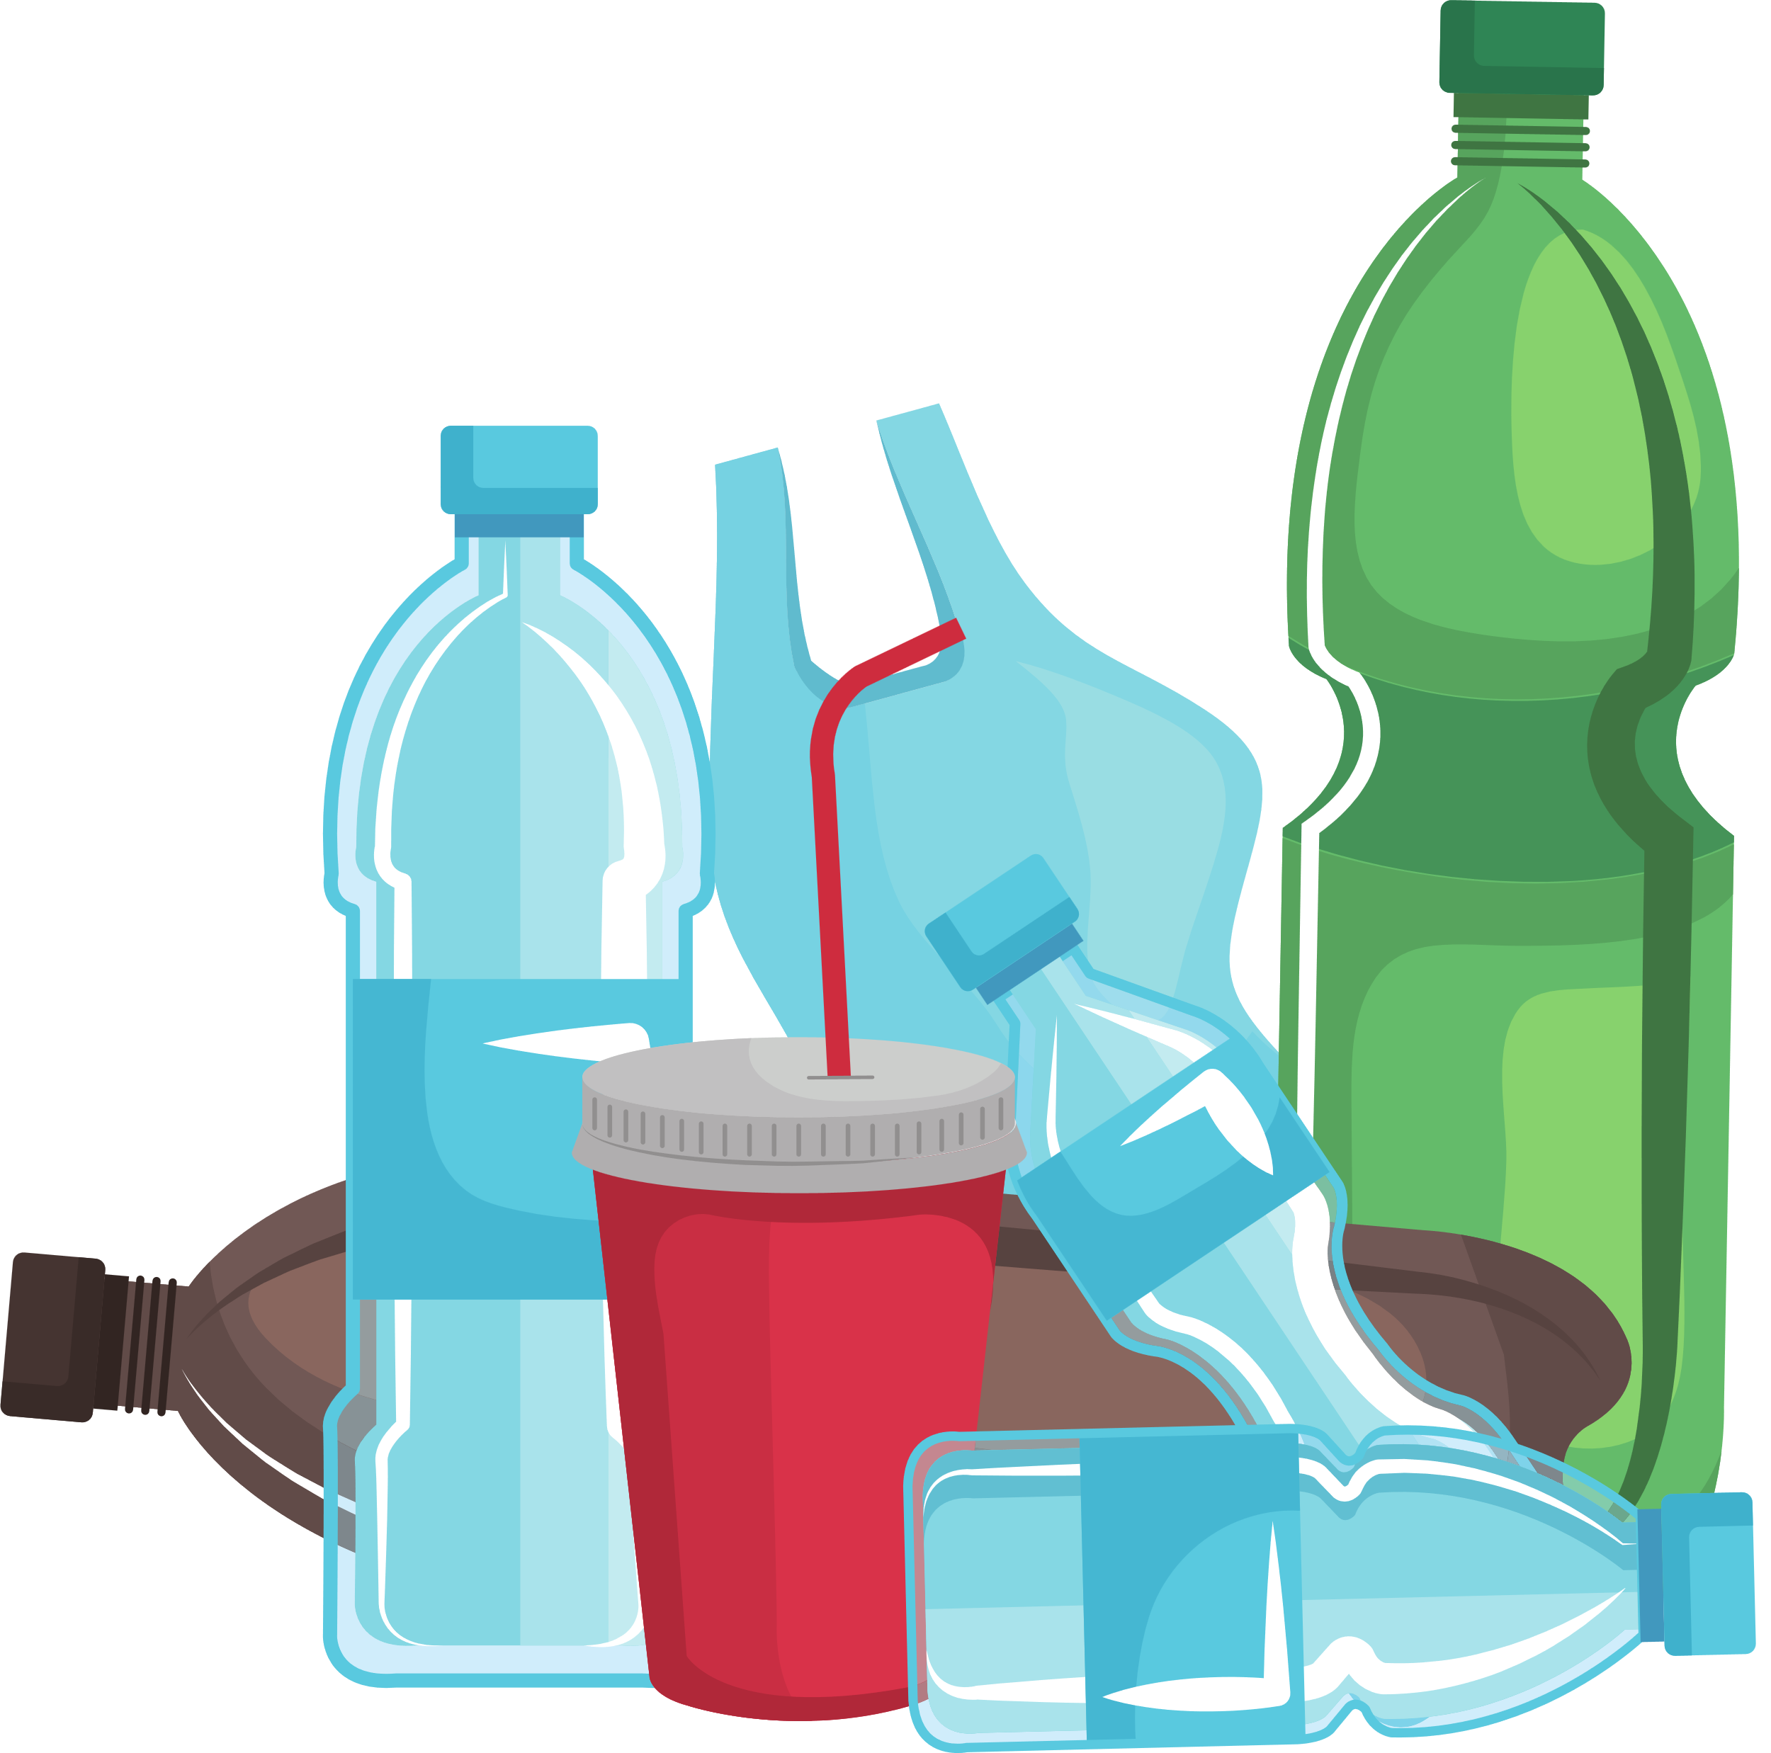
PLASTICS QUIZ
What happens to plastic waste when left in the environment?

Slide 15
PLASTICS QUIZ
It never goes away!
Plastic breaks into tiny pieces and is extremely harmful to our environment and wildlife. These small plastic particles, known as microplastics, are a major threat to our ecosystems. They can be ingested by marine animals, leading to serious health issues and even death. It is crucial for us to reduce our plastic consumption and properly dispose of plastic waste to protect our planet.

Slide 16
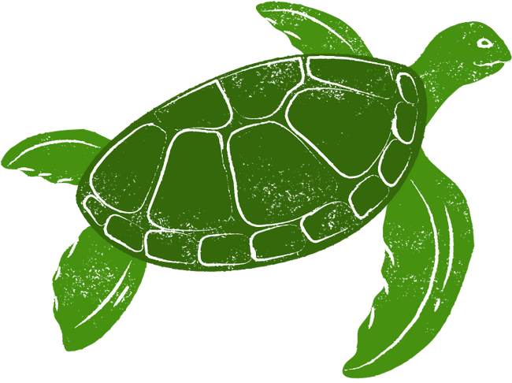
PLASTICS QUIZ
How many million tons of plastic are dumped in our oceans every year?

Slide 17
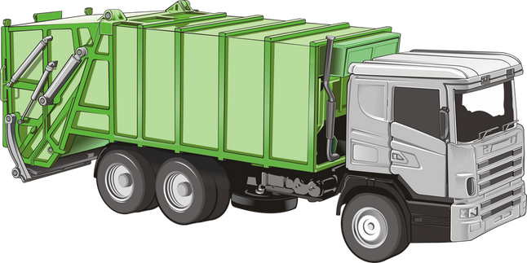
PLASTICS QUIZ
11 million tons!
At least 11 million tons of plastic is dumped into our oceans each year. That’s the equivalent of dumping one garbage truck full of plastic into the ocean every minute.
If nothing is done, this will increase to two garbage trucks a minute by 2030 and four per minute by 2050!

Slide 18

PLASTICS QUIZ
By what year do scientists predict plastic will outweigh fish in the ocean?

Slide 19

PLASTICS QUIZ
2050!
By 2050, scientists predict that plastic will outweigh fish in the ocean. This forecast is based on current trends in plastic production, consumption, and waste management, which have led to vast amounts of plastic debris entering marine ecosystems every year.

Slide 20
Thank you for watching our assembly.

