Slide 1


Welcome
We would like to share with you
An understanding of behaviour here at CtS – Caring Behaviour
Our plans for homework
How CtS is progressing on its journey ‘To Good and Beyond’

Slide 2


Why Caring Behaviour
Behaviour here at CtS is generally very good
As in any school there are a few children who display behaviours that cause us concern
COVID has made us reflect on some of our policies and procedures
We have become far more aware of children’s wellbeing and what that looks like in their behaviours and relationships
We’ve thought about how we understand behaviour here at CtS
We’ve questioned - how do we live our vision and values in school behaviour?

Slide 3

Our Vision Statement
At Christ the Sower Ecumenical Primary School we provide the ‘good earth’ for all our children to flourish; where every child can learn and explore who they are created to be, with the high expectation that we, individually and collectively, will enable every child to be and do the best they can.
A loving place where we all care, learn and grow together.

Slide 4
How do we live our vision?
By placing the child at the heart of what we do:
Through our Values
Through British Values
Through ODBST Values
Through our Curriculum
Through CARE

Slide 5
Our School Values
Friendship
Thankfulness
Courage
Forgiveness
Compassion
Respect
Perseverance

Slide 6
Through British Values
Democracy
The Rule of Law
Individual Liberty
Mutual Respect
Tolerance of Different Faiths and Beliefs

Slide 7
Through ODBST Values
(Shared CofE Educational Values)
Wisdom
Community
Hope
Dignity

Slide 8
Through Our Curriculum
Teaching SMSC is an important part of the National Curriculum.
Social
Moral
Spiritual
Cultural
Teaching behaviour is our responsibility as a school, just as teaching Maths and English is.

Slide 9
Forming Policy
How do we bring all of the above together to form our policy?
How do we enable the children to understand our vision and values?
How do we deliver this on a day to day basis in the classroom?
How do we help the children to learn, grow and flourish and become the best they can be?

Slide 10
Through CARE
At CtS our vision statement says that we offer – A loving place where we all care, learn and grow together.
C – Choices
A – Appreciation
R – Reflection
E – Engagement

Slide 11
CARE
C – Choices – Moral – Compassion & Perseverance – Individual Liberty & The Rule of Law - Hope
A – Appreciation – Cultural – Respect & Thankfulness – Mutual Respect & Tolerance of Different Faiths & Beliefs - Dignity
R – Reflection – Spiritual – Forgiveness - Tolerance of Different Faiths & Beliefs - Wisdom
E – Engagement – Social – Friendship & Courage – Democracy & Rule of Law - Community

Slide 12
Policy Intention
Children understand CARE
Children articulate CARE
Children learn and grow behaviours
Children can explain what happens if their behaviour is poor
Children understand what will happen if their behaviour is good/outstanding
Children’s behaviour for learning supports their achievement
Positivity around the school
Behaviour at CtS is brilliant

Slide 13
Policy Intention
Together we follow our 4 school rules:
1. Make Good Choices
2. Appreciate ourselves, others and our surroundings
3. Reflect on ourselves, our learning, experiences and events
4. Engage with each other, our learning and opportunities

Slide 14
Caring Behaviour at CtS
Choices
Be given the opportunity to make choices
Making good choices
Explaining choices and consequences
Practising choices
Praising and celebrating good choices

Slide 15
Caring Behaviour at CtS
Appreciation
Appreciating ourselves
Appreciating our belongings and school
Appreciating others have different points of view
Appreciating diversity, similarities and differences

Slide 16
Caring Behaviour at CtS
Reflection
Taking part in times of reflection
Reflection activities for learning
Reflecting on events, news, issues
Celebrating reflection

Slide 17
Caring Behaviour at CtS
Engagement
Join in and have a go
Work hard
Demonstrate and celebrate resilience
Include all children - ensuring equal opportunity

Slide 18
Policy Implementation
Model and teach behaviour to improve children’s behaviour
Be visibly consistent
Provide good and outstanding teaching and learning to provide opportunity for good and outstanding behaviours
Teach and re teach expected behaviours – don’t expect certain behaviours by a certain age

Slide 19
Policy Implementation
Use recognition boards for good behaviour
Any adults and children can nominate names for recognition boards
Recognise good and outstanding behaviour even if children have received sanctions for something
Responds to behaviour proportionately
Respond immediately
Don’t over praise expected behaviour
Keep positive and negative separate

Slide 20
Policy Implementation
Regularly catch good & outstanding behaviour
Comments, stickers, stamps and giving feedback on the children’s work
CARE Board – aim to get every child’s name on the board every week
Recognition for effort and achievements
Dojo points – to celebrate demonstration of good choices, appreciation, reflection and engagement
Dojo points = House points = House Cup
Golden afternoons
Praise in weekly celebration assembly – Golden Book – shared with parents
Head Teacher stickers awarded in the office

Slide 21
Policy Implementation
When behaviour goes wrong we will support children by following our 7 step approach
The idea is to limit conversation to 30 seconds:
go in
deliver the message
anchor the child’s behaviour with an example of previous good behaviour
get out
It leaves the child thinking about their actions and knowing that someone believes they are better.

Slide 22
Policy Implementation
1 Reminder
A reminder of the 4 simple rules (choices, appreciation, reflection and engagement). Delivered privately wherever possible.
2 Caution
A clear verbal caution delivered privately, wherever possible, making the child aware of their behaviour and clearly outlining the consequences- Think carefully about your next step
3 Last chance
Speak to them privately and give them a final opportunity to engage. Offer a positive choice to do so and refer to previous examples of good behaviour (30 second script)
4 Time out
Short period outside the room/hall/playground/field, It is a few minutes for the child to calm down, look at situation from different perspective and compose themselves.
5 Repair
This might be a quick chat or a more formal meeting. This meeting will be supported by the member of staff who spoke to the child or Mrs Robertson or Mrs Wilson Andoh if the event took place at lunch time.

Slide 23
Policy Implementation
6 Escalation
Red Card -This is to support a child/group of children’s behaviour if they have caused injury to another person/destroyed school property/caused safety concerns/racist/bullying/abuse/extreme rudeness/repeated swearing or caused serious disruption to learning.
We will work to support the child in better understanding their behaviour through a restorative session. Parents may be contacted at this stage. A Red Card may be sent home and parents asked to sign the card returning it to school the next day.
This type of behaviour might have built up over time or be a one off. Therefore steps 1-5 may not be appropriate.
Mrs Wilson Andoh and Mrs Robertson will make the decision to follow through with an escalation and will support staff if there will be no escalation. This may be a Stage 1 Individual Behaviour Plan for a maximum of 4 weeks before moving to further escalation
Behaviours that require a Red Card and/or escalation are recorded on CPOMS

Slide 24
Policy Implementation
7 Additional Interventions
On occasions it may be appropriate for a child or groups of children to receive additional support over a specific period of time. This may be in the form of a Stage 2 Individual Behaviour Plan that is independent/in tandem with our usual behaviour support. Parents will be informed of the plan
This would be achieved through a Provision Map or a Stage 2 Individual Behaviour Plan in consultation with appropriate people who could be the class teacher, parents, SENDco – Mrs Summerfield, -Inclusion and Wellbeing Lead - Mrs Robertson, Deputy Headteacher – Mrs Wilson Andoh

Slide 25
Being Positive
Be the school where we
Focus on the positive
Share positivity in class and around the school
A loving place where we all care, learn and grow together.

Slide 26

Homework

Slide 27
Homework
In the summer term 2020 Mrs Whittle undertook a consultation project on homework. She consulted:
Teachers
Children
Parents
As expected there was not a clear agreement on what homework should look like here at CtS.

Slide 28
Teachers
Most
Like the projects
Reading every day
Spellings and tables practice every day
Homework should be independent
Marking and feedback should not be increased

Slide 29
Children
Most
Like doing the projects
They get the right amount but some KS2 children would likea little more
It shouldn't be harder
Parents shouldn’t do the project for them

Slide 30
Parents
Most:
Don’t like projects
Challenge is about right
Children enjoy doing homework
Want homework linked to Maths and English
Want to help their children with homework
Don’t want their children blamed if they haven’t completed the homework

Slide 31
Going Forward
Foundation – all children will be expected to read daily, wherever possible.
Key Stage 1 – all children will be expected to read daily, wherever possible and learn spellings for a weekly test. New spellings will be given out on a Friday and tested the following Friday. Foundation children will also be expected to practise common exception words.
Key Stage 2 - all children will be expected to read daily, wherever possible, and learn spellings for a weekly test. New spellings will be given out on a Friday and tested the following Friday. Children must also complete a minimum of 5 Garage games on Times Tables Rockstars weekly (new games are set on Friday to be completed by the following Thursday).
A weekly Maths and English task will also be set using the online platforms MyMaths and Reading Eggs respectively. These will support learning in class and will be explained to children before they become live. It is our intention not to set homework that child a cannot already do i.e parents are not expected to teach new skills. Tasks will be set on Thursday and should be completed by the following Tuesday.
Children will be expected to complete 4 pieces of Maths and English during each half term period. They will receive 2 dojos for each piece of work submitted, with those children meeting the minimum requirement being given a certificate of achievement.

Slide 32


Reading Eggs and Reading Eggspress
Parents Meeting
Monday 18th October 2021

Slide 33
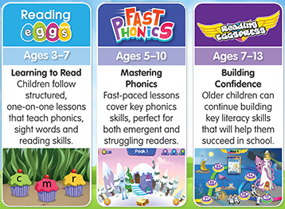
Notes:
Reading Eggs is an umbrella term which covers three programmes that we are using in school to support children to develop their reading skills and comprehension.
There are three programmes available in our current subscription to the service, these are:
Reading Eggs – a phonics based reading comprehension programme aimed primarily at KS1 or those children who are still developing their phonetic understanding. Comprehension based lessons are also included as part of this programme.
Fast Phonics – this is designed for emergent and early readers, as well as older children with gaps in their core reading knowledge.
Reading Eggspress – this a reading comprehension programme which is aimed at KS2 children, it includes spelling and grammar elements as well as reading.

Slide 34
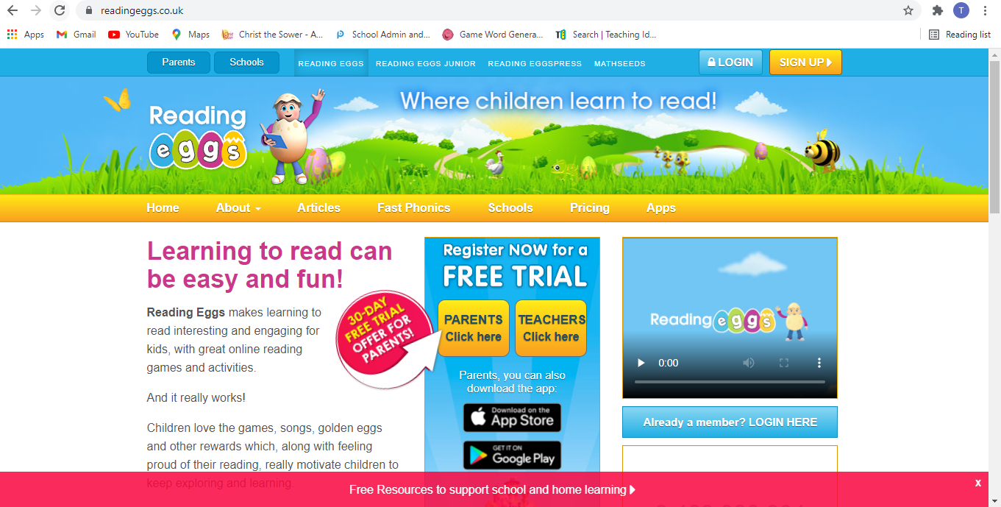
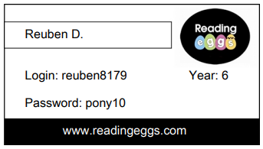
Name
www.readingeggs.co.uk

Slide 35
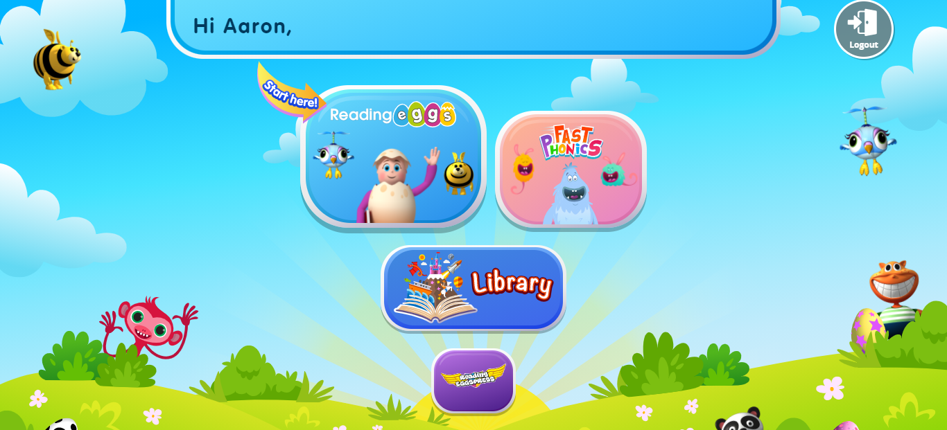
Key Stage One Login Screen

Slide 36
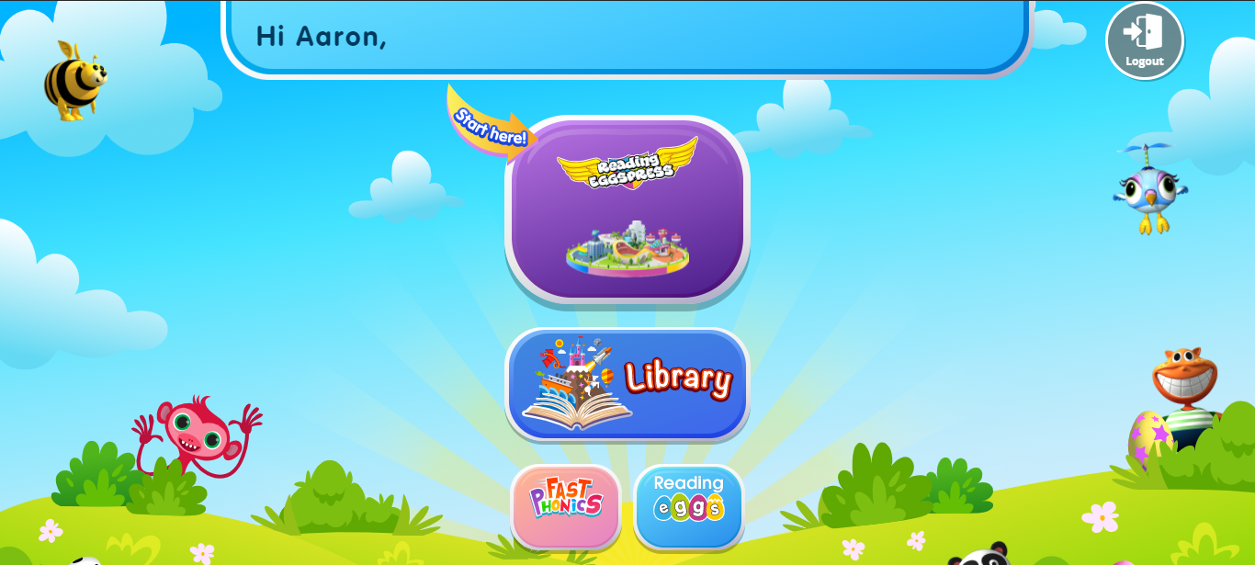
Key Stage Two Login Screen

Slide 37
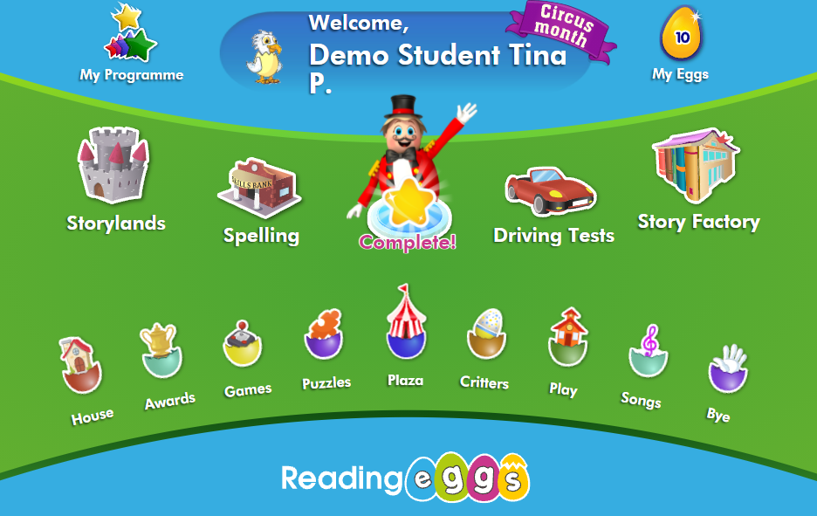

Slide 38
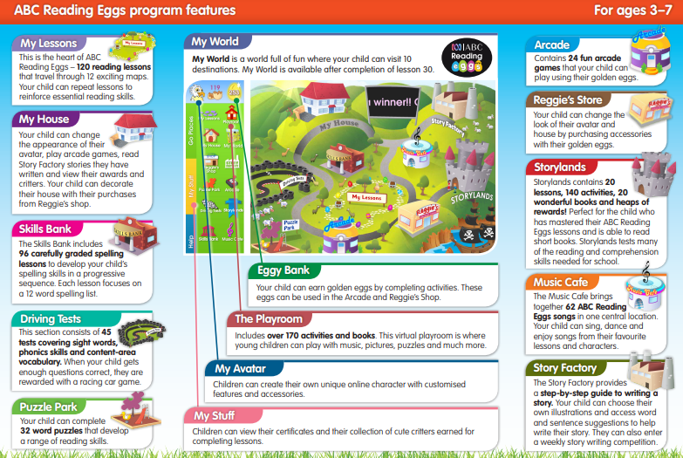

Slide 39
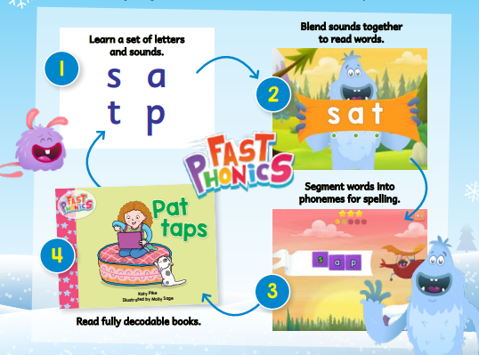

Slide 40
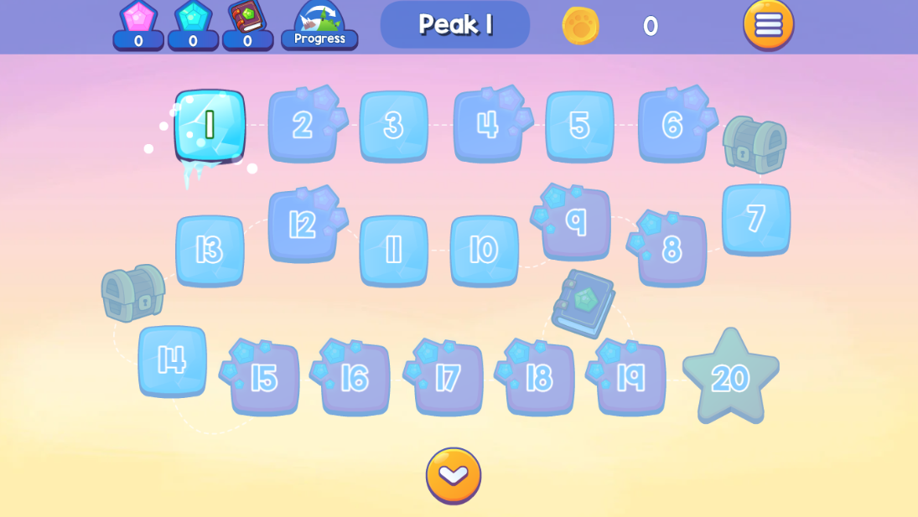

Slide 41
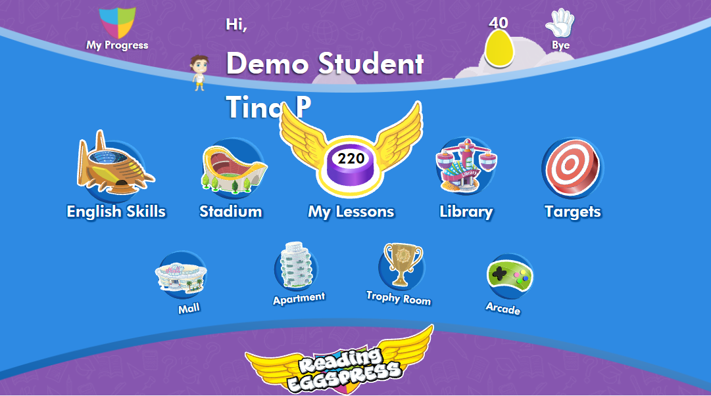

Slide 42
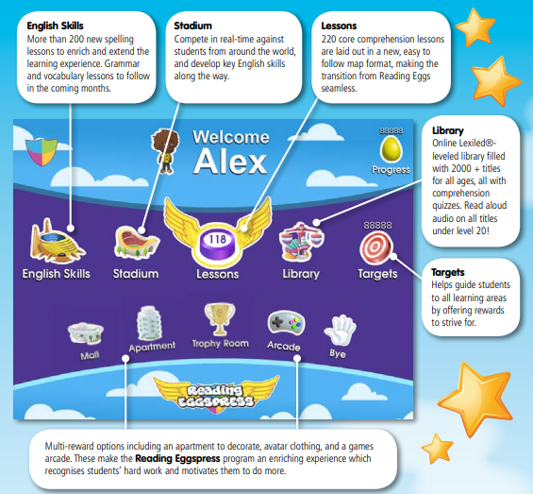

Slide 43
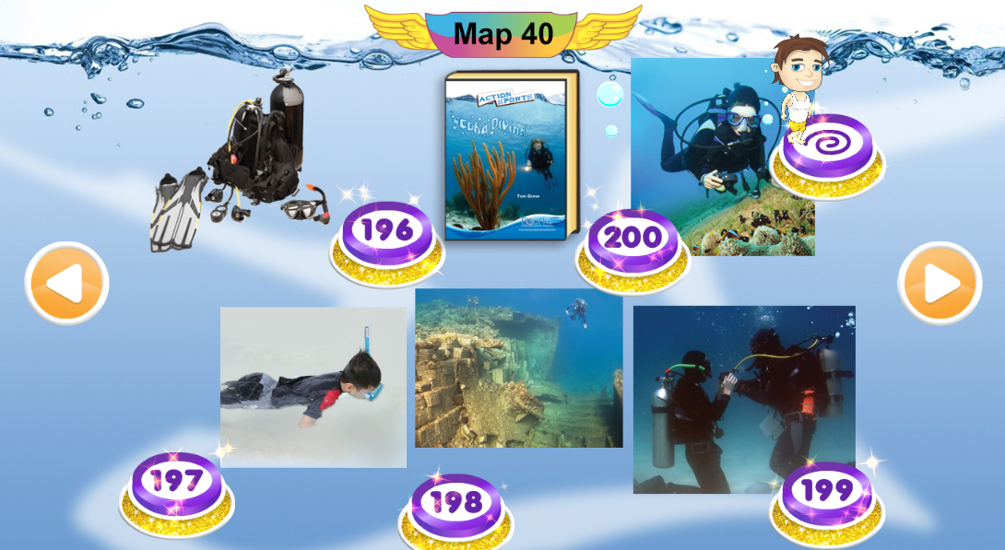
Lessons

Slide 44
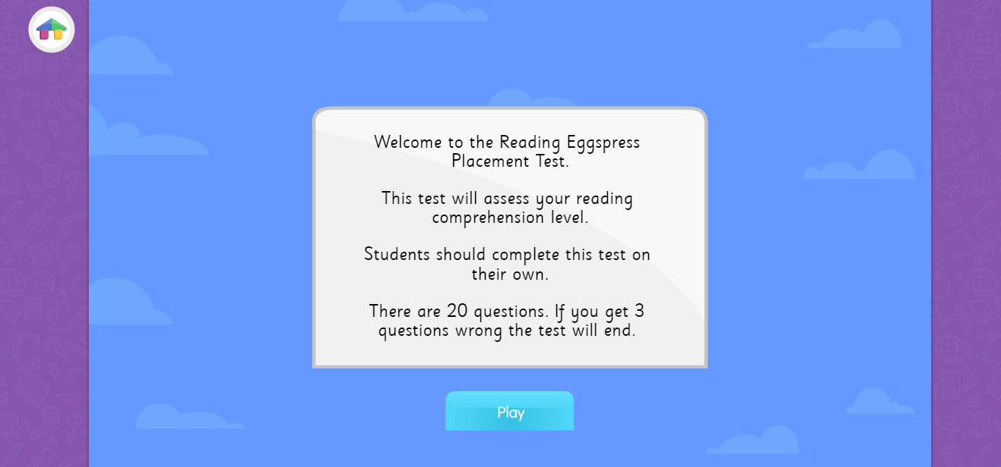
Lessons

Slide 45
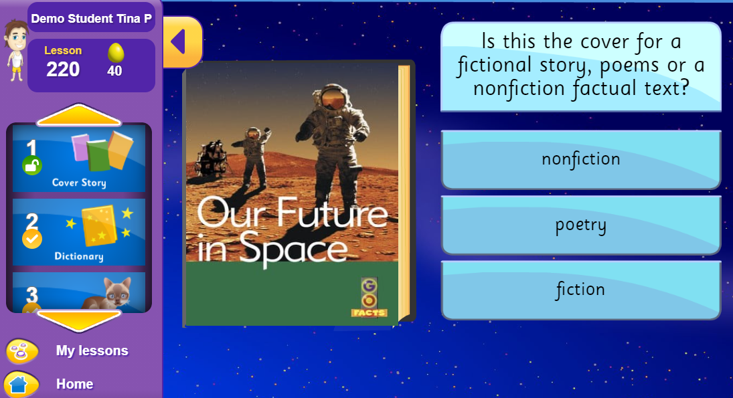
Lessons

Slide 46
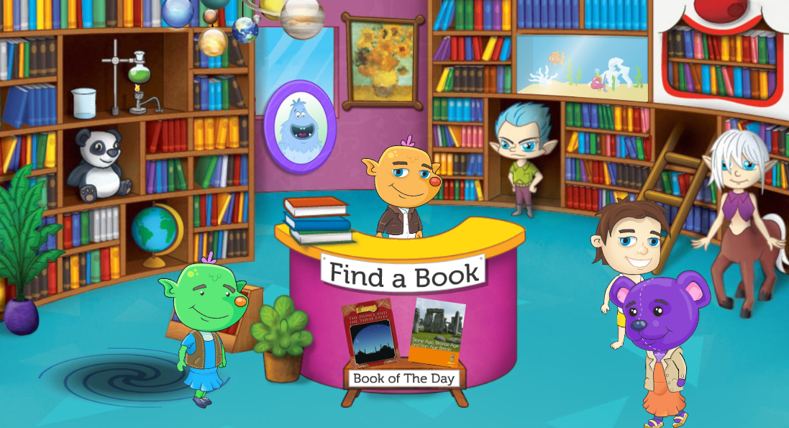
Library

Slide 47
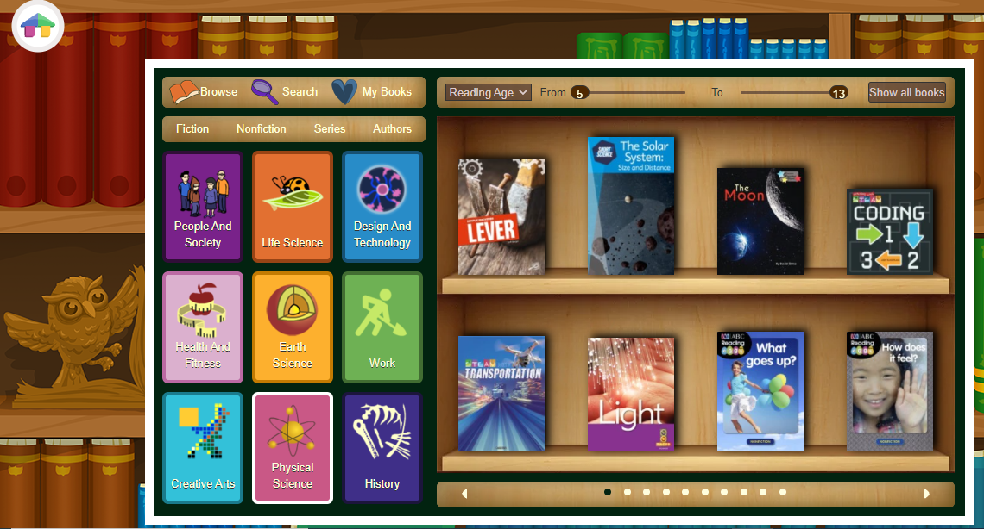
Library

Slide 48
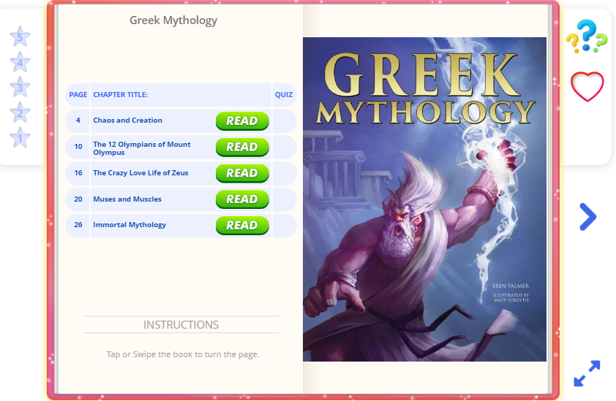
Library

Slide 49

Library

Slide 50
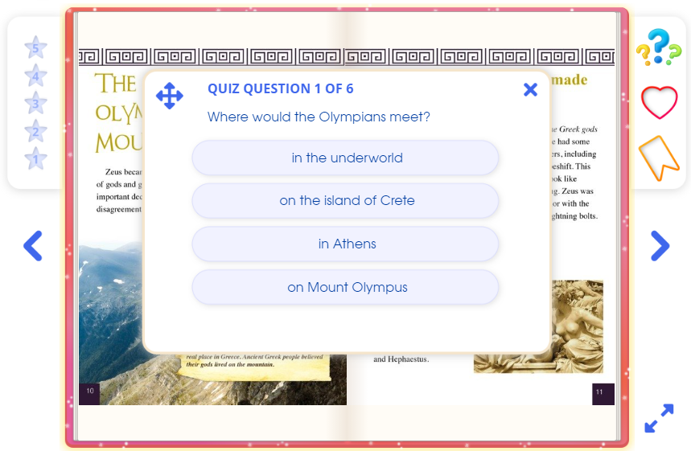
Library

Slide 51
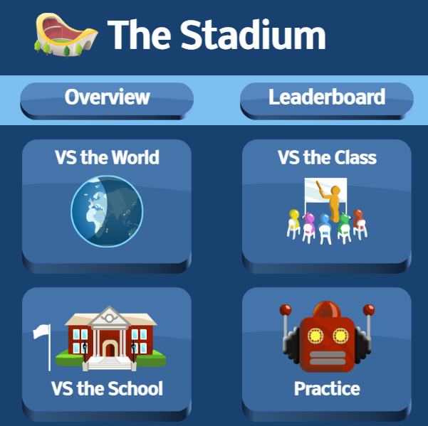
Stadium

Slide 52
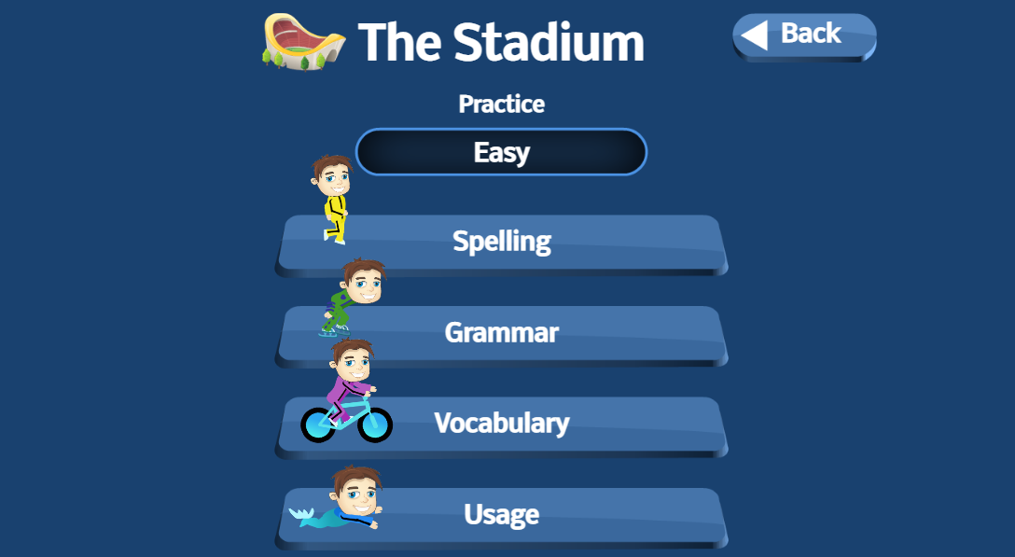
Stadium

Slide 53
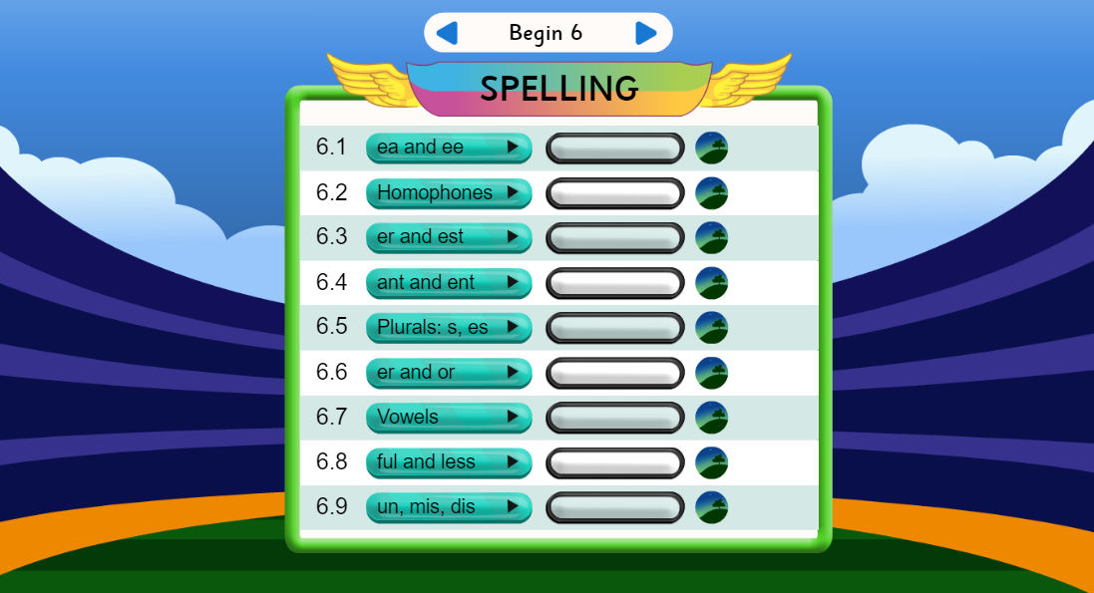
Spelling

Slide 54

Spelling

Slide 55
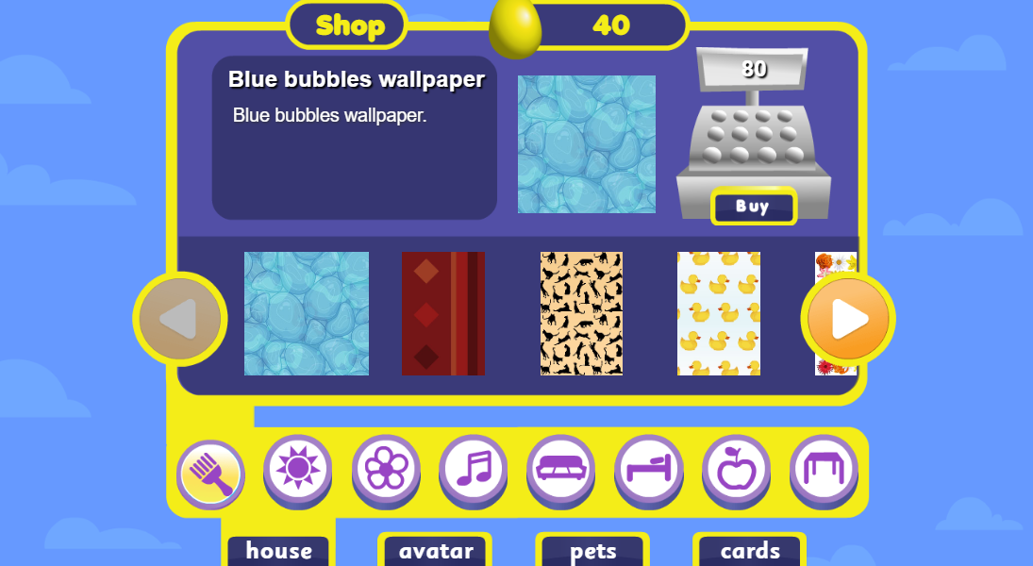
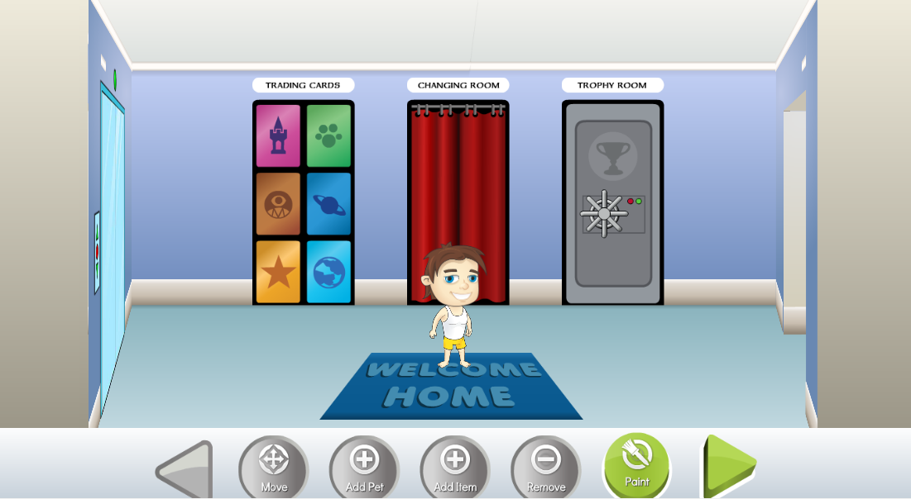
Mall and Apartment

Slide 56
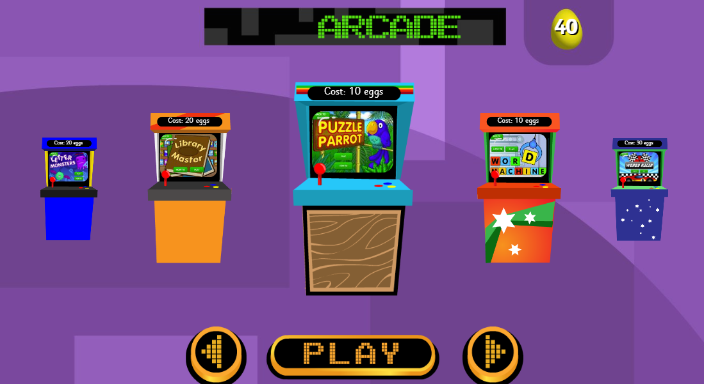
Arcade

Slide 57
Using Reading Eggspress for Home Learning

Slide 58
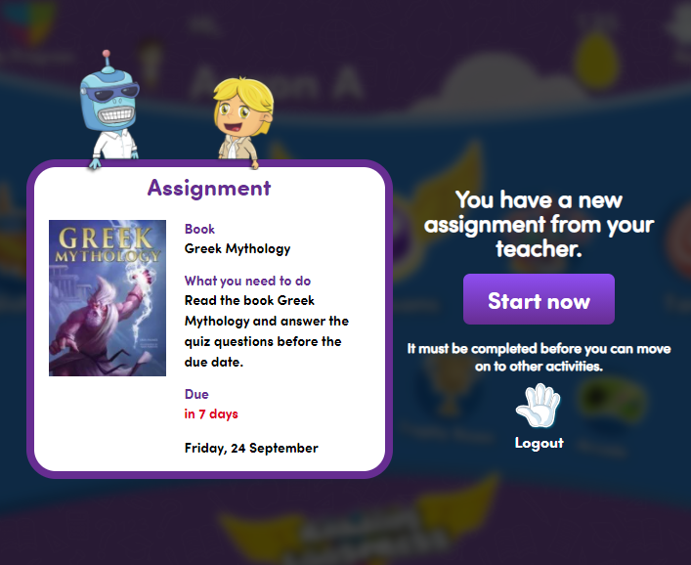
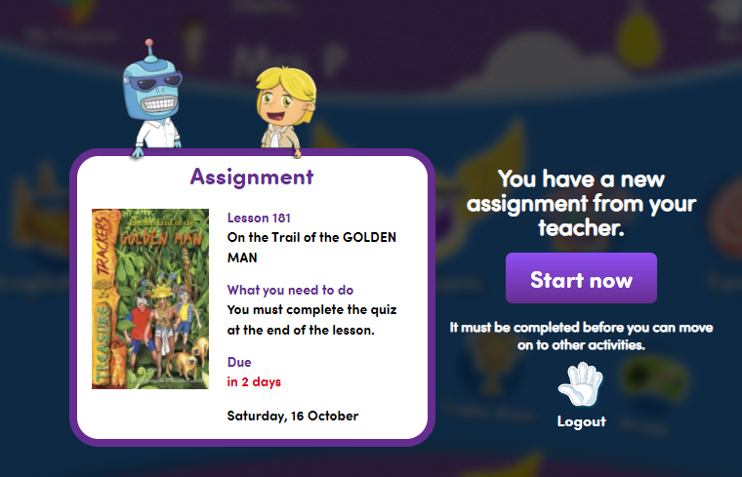

Slide 59
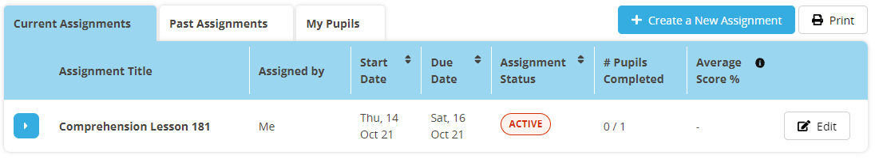
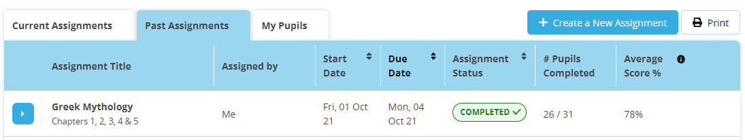

Slide 60
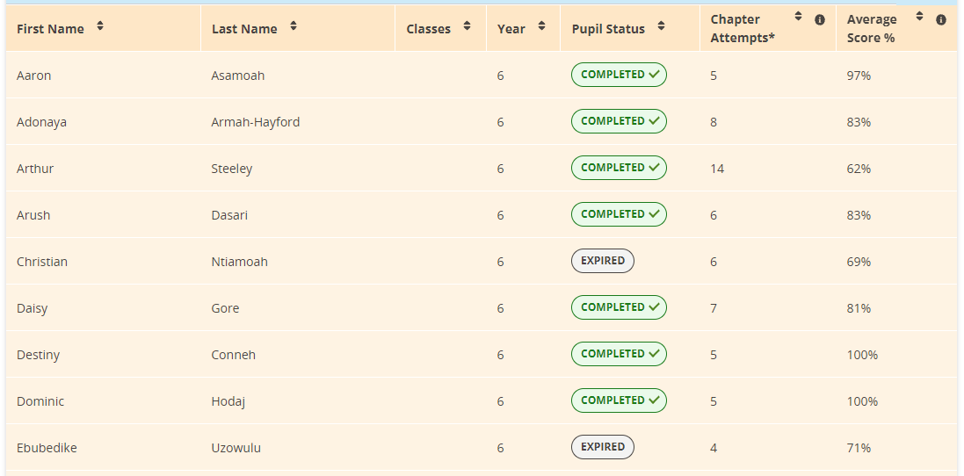

Slide 61

To Good and Beyond

Slide 62
The school in 2018
Negative:
Overall effectiveness - Inadequate
Effectiveness of leadership and management - Inadequate
Quality of teaching, learning and assessment - Inadequate
Personal development, behaviour and welfare - Requires improvement
Outcomes for pupils - Inadequate
Early years provision - Requires improvement

Slide 63
The School in 2018
Positive:
The interim leadership team has a very accurate view of the school’s strengths and weaknesses. They are ambitious, experienced and keen to see the school improve.
Pupils are well mannered. Many show high levels of respect towards adults and try their best.
Pupils read widely and often. Many say they enjoy reading for pleasure. In this subject, pupils achieve well, including in the early years.
Safeguarding is effective. Temporary leaders have ensured that the school’s systems and processes are fit for purpose.

Slide 64
Where Are We Now?
A quick recap:
November 2018 the school was judged as Inadequate and was placed in Special Measures by OFSTED
September 2018 – 2019 Milton Keynes put an interim Leadership Team in place for 1 academic year
January 2019 the Regional Schools Commissioner asked the ODBST to take Christ the Sower into the Multi Academy Trust (MAT)
Summer 2019 the ODBST worked with the Interim leadership Team to handover the school
September 2019 Lorraine Quirk appointed as Executive Headteacher
February 2020 Lorraine Quirk appointed as Substantive Headteacher
And then……………….

Slide 65
COVID Struck!!
March 2020 – May 2020 (1st National Lockdown) the school was open for key worker and the more vulnerable children only
May 2020 – July 2020 the school was open to key worker and the more vulnerable children, YR & Y and Y6.
September 2020 the school is open to all children in bubbles and COVID precautions
January 2021 – 1st June 2021 (2nd National Lockdown) – schools closed to all but key workers and more vulnerable children
June 2021 school open in bubbles with COVID precautions
September 2021 – school reopens – nearly normal!

Slide 66

Quite a Journey!

Slide 67
Key Areas for Improvement
Strengthen the quality of leadership and management, including in the early years and governance
Improve the quality of teaching and learning to accelerate pupils’ progress

Slide 68
Leadership & Management
  a sustainable leadership and governance structure is established - A sustainable and effective leadership team has been established with a substantive Headteacher and Deputy Headteacher. Governance is now ready to move over to a local governing body, for the last 2 years we had an Interim Academy Committee. The LGB has a parent governor, staff governor, Rev. Mike Morris, an Assistant Headteacher from Hazeley School, an ex headteacher and an ex ODBE Advisor, a representative from the ODBST as well as 2 governors from the wider community. The first LGB meeting is next month.
  middle leaders develop the skills and expertise needed to oversee their subjects or departments effectively - An increasing number of middle leaders are being nurtured and support to lead effectively. Three teachers have successfully achieved their MLQS (Middle Leader Quality Standard) Award, two at the bronze level and one at silver.

Slide 69
Leadership & Management
teaching and support staff receive sufficient training to carry out their roles effectively - All staff across the school have been provided with training and support to help them be more effective. The quality of teaching overall is now good with some elements of outstanding in some classrooms. Where it needs to improve further support is put in place.
the curriculum meets the needs of all pupils more precisely - The curriculum was adapted during lockdown to specifically meet the needs of pupils and the CTS Cultural Curriculum is well on the way to being implemented fully.

Slide 70
Leadership & Management
  staff performance management is regularly monitored and reviewed so that staff are held more firmly to account - All staff are now provided with appraisals and are being held to account for the learning in their classrooms.
  the school’s finances are kept under watchful review and evaluated for value for money - In partnership with Trust Officers the school is maintaining a very close eye on the budget and planning accordingly. This is difficult and challenging as we are working within significant financial restraints.
  the school’s website meets requirements - Improving, but there are still some aspects that need reviewing, especially around sharing details of our curriculum. The new requirements to share Intent, Implementation and Impact with parents is being worked on by staff over the course of this year and will be added to the website over time.

Slide 71
Teaching and Learning
  disadvantaged pupils and pupils with SEND are helped to catch up and achieve well - This has been a priority for school leaders. These pupils are now being supported very effectively in all respects. We have a very good SENDCo in Mrs Summerfield who knows the children well and has a very good understanding of teaching and learning and how to support children. Mrs Wilson Andoh is our PP Champion.
  pupils receive their entitlement to a broad and balanced curriculum - Pupils received the best curriculum for where they were in their learning during lockdowns. The CTS Cultural Curriculum is well on the way to being implemented fully. During lock down we didn’t teach some subjects such as French and D&T but these are now being reintroduced.

Slide 72
Teaching and Learning
  Teachers have higher expectations of what pupils of different capabilities can achieve, particularly in reading, writing, mathematics and science – We have worked really hard to raise the expectations that teachers have of the pupils they work with. High aspirations for all pupils is now a shared part of the ethos and culture at the school. The programmes of study for these core subjects have been re-written and the positive impact on learning can already be seen in Reading, Writing and Maths. Science, through STEM was rolled out last term.
  activities in lessons cater well for pupils of all abilities and are pitched to take account of pupils’ needs, including those of the most able - Continues to improve.

Slide 73
Teaching and Learning
  teachers’ subject knowledge improves so that explanations are modelled clearly and usefully to pupils - Training for staff both from within the school and from the Trust have improved the subject knowledge of teachers so that the quality of teaching across the school is now good. The Power Maths Scheme has supported subject knowledge and provides a clear structure for learning.
  teaching assistants develop their skills and expertise to have a positive impact on pupils’ learning - Teacher assistants have received training, are taking part in performance management and are enthusiastic to develop and work with the pupils. We have some highly skilled and effective TAs here at CtS.
  pupils’ presentation and pride in their work improves - There is a different feel around the school now. Pupils respond well to the extra challenge and want to do well.

Slide 74
Making the Difference
The ODBST created a SofA - Statement of Action
The ODBST recruited a Headteacher to implement the SofA
Annual School Development Plan – prioritises actions for each year over a 3 year period which includes:
Making the children the most important people in the school
Raising expectations for children
English and Maths schemes of work
Driving up the quality of Teaching & Learning
Performance Management and supporting teaching where needed
Challenging when the children haven’t made good progress
Understanding & assessing pupil progress

Slide 75
Making the Difference
School Environment – raising standards
Introducing the non negotiables of teaching expectations and performance
Designing and introducing the CtS Cultral Curriculum
Creating the COVID Recovery Curriculum
Creating the Rainbow Curriculum
Creating the role of Inclusion and Wellbeing Lead
Recruiting teachers to improve teaching and learning
Recruiting & supporting staff to lead specific areas of the school
Creating a whole school culture of driving improvements
Establishing a shared school vision and values to underpin our work and drive improvements

Slide 76
Making the Difference
Introducing Power Maths
Introducing our STEM Curriculum
Introducing Feedback and Marking expectations
Introducing the new PSHE Curriculum
Provide opportunities for training
Achieving the Gold award (FCQM) for working with families
Developing middle leaders through ODBST Middle Leader Quality Mark
Introducing our new approach to behavior
Creating purpose around the school
Six mini inspections (ODBST) a year that focus on different aspects e.g. SEN, PP, personal development
Annual ODBST evaluation of journey to Good and Beyond

Slide 77
Plans for 2021 - 2022
Create Intent, Implementation and Impact policies for all subjects
Create Knowledge & Skills organisers for all Subjects
All Curriculum documents are on the website
Follow through with our CtS Enrichment Curriculum
Ensure CtS Cultural Curriculum is meeting the needs of all gaps in knowledge and skills
Become an Eco School
Develop the outside Learning Environment
Reintroduce more parental involvement with the school e.g. Parent Teacher Association (PTA)
Introduce Class Representatives
Four middle leaders achieve Silver Awards for leadership – English, PSHCE, Humanities and Science
Increase numbers in the Foundation Stage
Move from a Yellow School to a Green School
Children in CtS are achieving in line with other children nationally

Slide 78
OFSTED
Due in the 3rd year of becoming an academy - 2021 – 2022
Your children remain at the center of all that we do here at CtS
Aiming for Good

