Slide 1


British
Values
Day

Slide 2


Let’s play a game of
‘Put your hand up if.....’

Slide 3
Put your hand up if........
You have brown hair
Wear glasses
Have a brother or sister
Like football
Can speak another language
You like swimming
Know what you want to be when you’re older

Slide 4

All these things help make up your identity – that’s who you are!

Slide 5
So what else makes up your personal identity?
Groups or clubs that you belong to – rainbows rugby, football....
What your interests or talents are – dancing, swimming ....
What things are important to you.
What your hopes are for the future.
Which people are important to you.
Your religion
The languages that you speak.
Which country you are from.

Slide 6


What you value also makes up part of who you are.
Time for another game – Let’s play ‘Thumbs up, Thumbs down’
I’m going to show you some words on the board – if you think that thing is important to you, if it is something you value, then give me a thumbs up – if not, it’s thumbs down.

Slide 7
Honesty
Courage
Respect
Perseverance
Laziness
Love
Compassion
Rudeness
Hurtful
Friendship

Slide 8
We have talked about personal and our school values, but can a country have values?
We all live in Britain, what do you think British values are?

Slide 9
We are going to be learning about British values
democracy
the rule of law
individual liberty
mutual respect
tolerance of those of different faiths and beliefs
We will be learning about these values in your classrooms this afternoon.

Slide 10
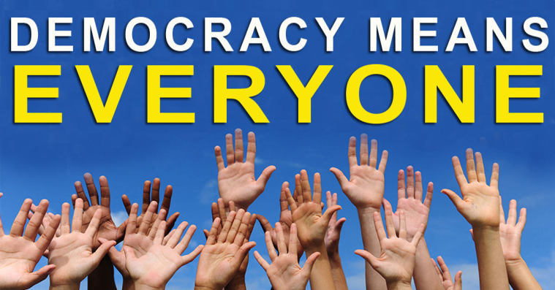
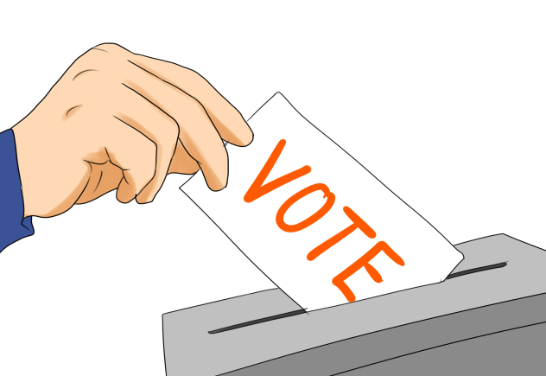
We are going to be learning about British values
Democracy

Slide 11
We are going to be learning about British values
What this looks like in our school?:
Democracy
We have a School Council
We have an Eco Council
We have Year 6 Leaders
Children have a say when we appoint new staff.

Slide 12

We are going to be learning about British values
The rule of law

Slide 13
We are going to be learning about British values
What does this look like in our school?:
The rule of the law
You are taught from Nursery about the ‘CARE Rules’ of our school.
You are taught the value of and reasons behind our school rules, the responsibilities that this involves and the consequences when rules are broken.
We have a variety of rewards when children keep the Rules including Golden Book, Golden Tickets, badges, and stickers.
These show children the rules are valued and in keeping them they will be rewarded.

Slide 14
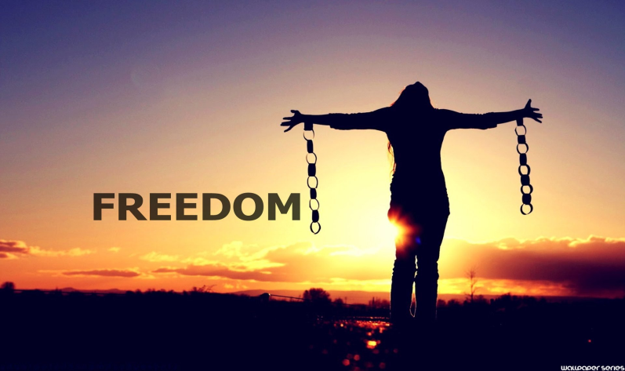
We are going to be learning about British values
Individual Liberty

Slide 15
We are going to be learning about British values
What does this look like in our school?:
Individual Liberty
You are taught to make good choices, knowing that you are in a safe and supportive place.
When you make a poor choice, we help you to reflect and learn from your mistake,
We look at E-safety and the importance of making safe choices when online.
You have the freedom to make your own choices, but you understand that there will be consequences for some poor choices.

Slide 16
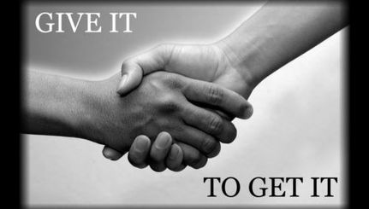
We are going to be learning about British values
Mutual Respect

Slide 17
We are going to be learning about British values
What does this look like in our school?:
Mutual Respect
Respect is one of our values.
Everyone is valued and has a contribution to make at our school.
Your behaviours have an effect on your own rights and those of others.
We expect you to give respect and to be respected.

Slide 18
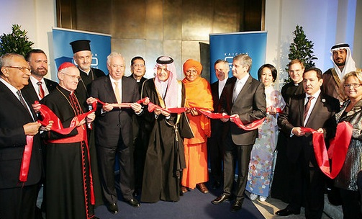
We are going to be learning about British values
Tolerance of those of different faiths and beliefs

Slide 19
We are going to be learning about British values
How does this look like in our school?:
Tolerance of those of different faiths and beliefs
All different faiths and beliefs are explored and celebrated through assemblies, RE sessions and a variety of visitors into school.
Your are taught that people have different faiths and beliefs and that these should be accepted.
Children within our school with different faiths are encouraged to share their practices and special celebrations.
We know that all faiths are equally respected and valued at CtS.

Slide 20

Take a moment to think about how lucky we are to live in Britain, a country with such strong values.

