Slide 1


Welcome to our
CARE
Celebration Assembly
24th October 2024

Slide 2





Aspiration
Reflection
Engagement
Choices

Slide 3

Golden Book Certificate
Aspiration
Excellent Writing

Slide 4
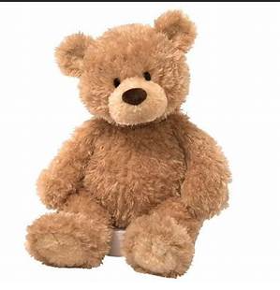
Attendance Bear
Barley: 98%

Slide 5


Slide 6




Slide 7

House Points

Slide 8
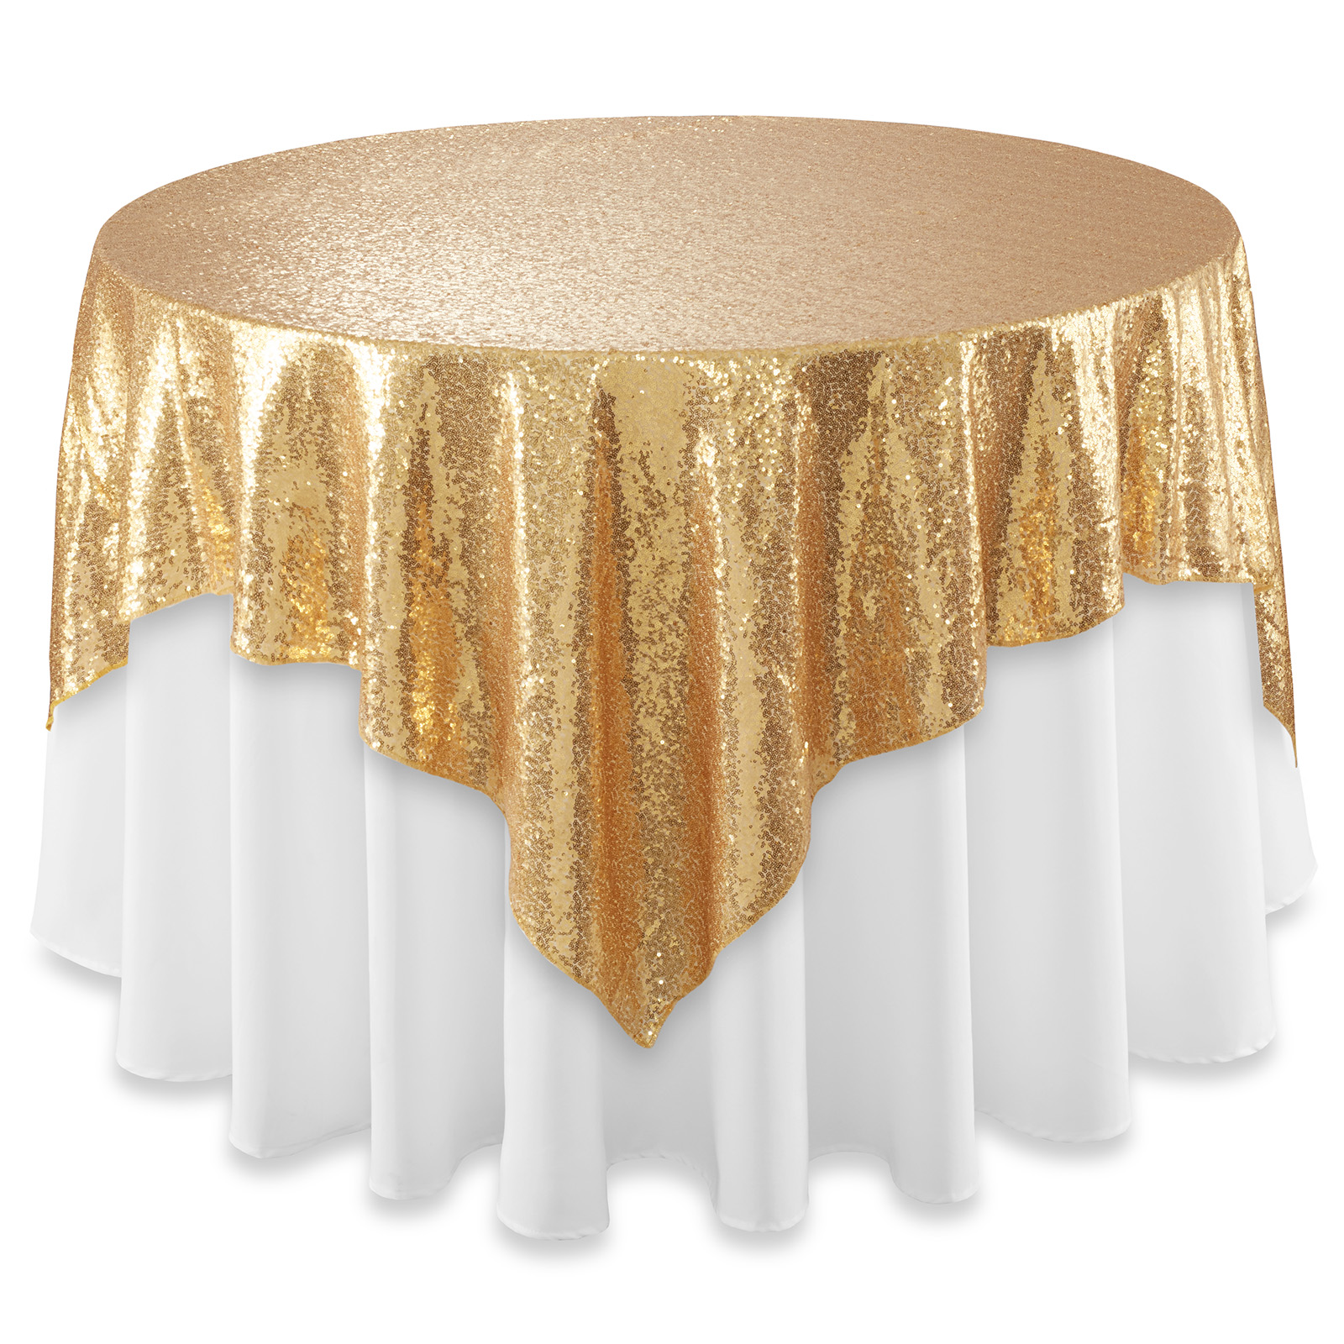
The Golden Table

Slide 9

Golden Book Certificate
Choices
Kind Friend

Slide 10

To help teachers lead collective worship.
To hold prayer and reflection sessions and clubs.
To lead on CARE and our school values.
To help CTS to spread our CARE message far and wide.
To be role models for all our children, to show how we live through CARE.

Slide 11
Our School Prayer
Dear God,
Teach us to learn, play and grow together.
Help us to be the soil that gives everyone life, health and CARE.
May we support one another to be the best that we can be, and to flourish.
Show us how to live peacefully and share with others in our school, in Milton Keynes and in our world. Amen.

