Slide 1


Slide 2


Welcome to our
CARE
Celebration Assembly
^{22nd} November 2024

Slide 3





Aspiration
Reflection
Engagement
Choices

Slide 4

Golden Book Certificate
Engagement
Awesome Artist

Slide 5
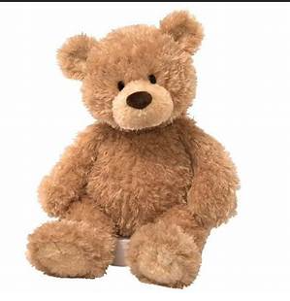
Attendance Bear
Acorn: 99%

Slide 6
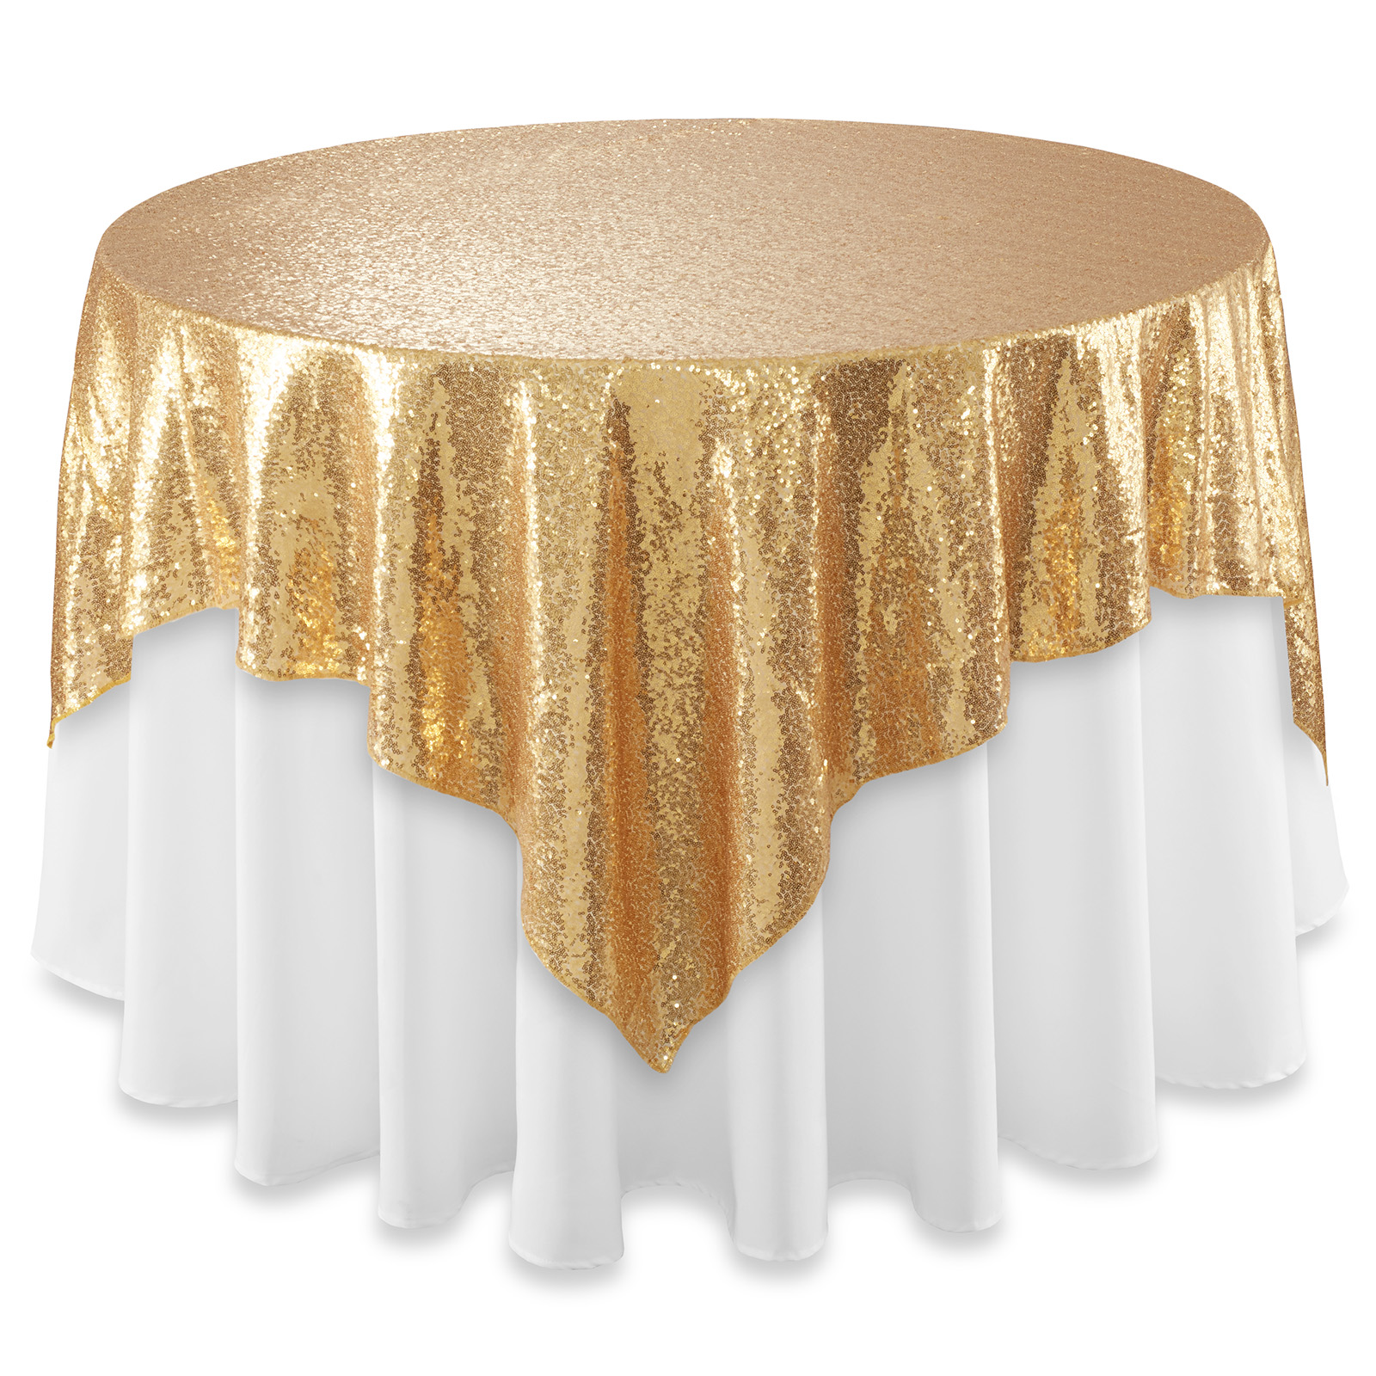
The Golden Table

Slide 7


Slide 8

Golden Book Certificate
Reflection
Superb Handwriting

Slide 9
Our School Prayer
Dear God,
Teach us to learn, play and grow together.
Help us to be the soil that gives everyone life, health and CARE.
May we support one another to be the best that we can be, and to flourish.
Show us how to live peacefully and share with others in our school, in Milton Keynes and in our world. Amen.

